Slide 1

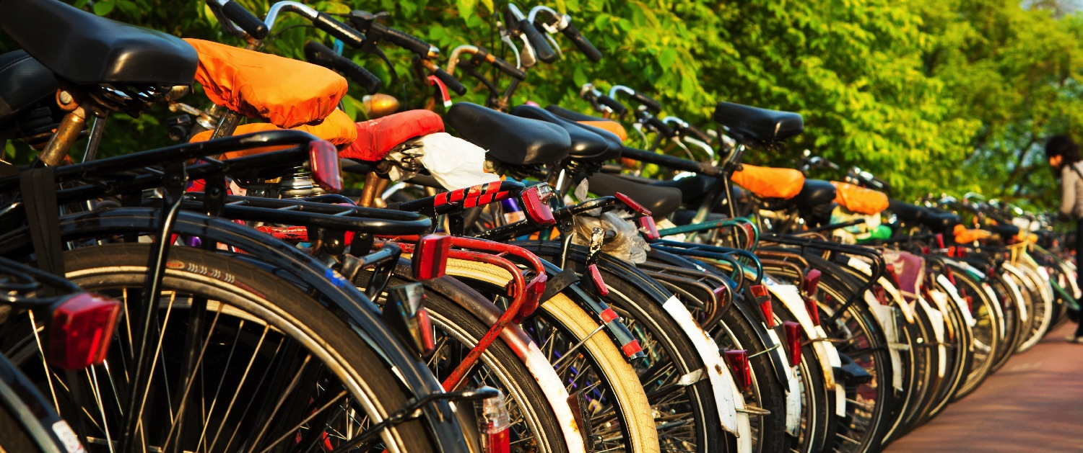
Creating a bicycle friendly university
[Insert name, affiliation and date here]
Notes:
[Thank your audience for coming and introduce yourself.]
The Bicycle Friendly University program is a program of the League of American Bicyclists and I am here to assist to get the most out of the program.

Slide 2

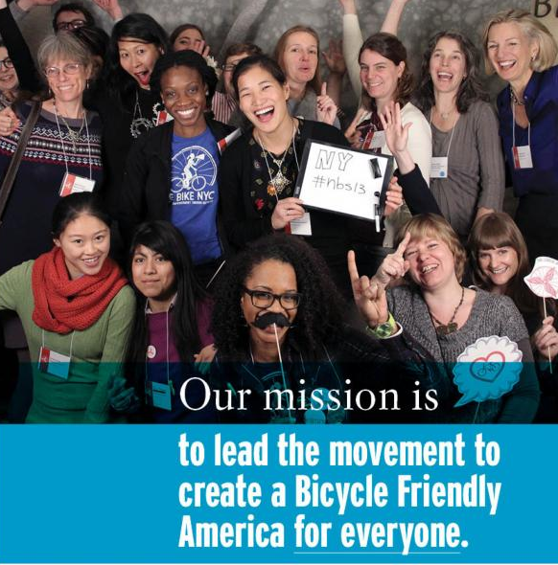
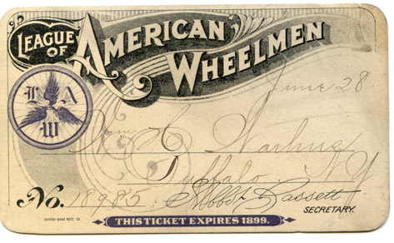
About the League
Notes:
The League was founded in 1880 and had big wins early to get the first paved roads for bicyclists. Today, the League continues to make biking better. Its mission is to promote bicycling for fun, fitness, and transportation through advocacy and education to build a bicycle-friendly America. As leaders, our commitment is to listen and learn, define standards and share best practices to engage diverse communities and build a powerful, unified voice for change.

Slide 3
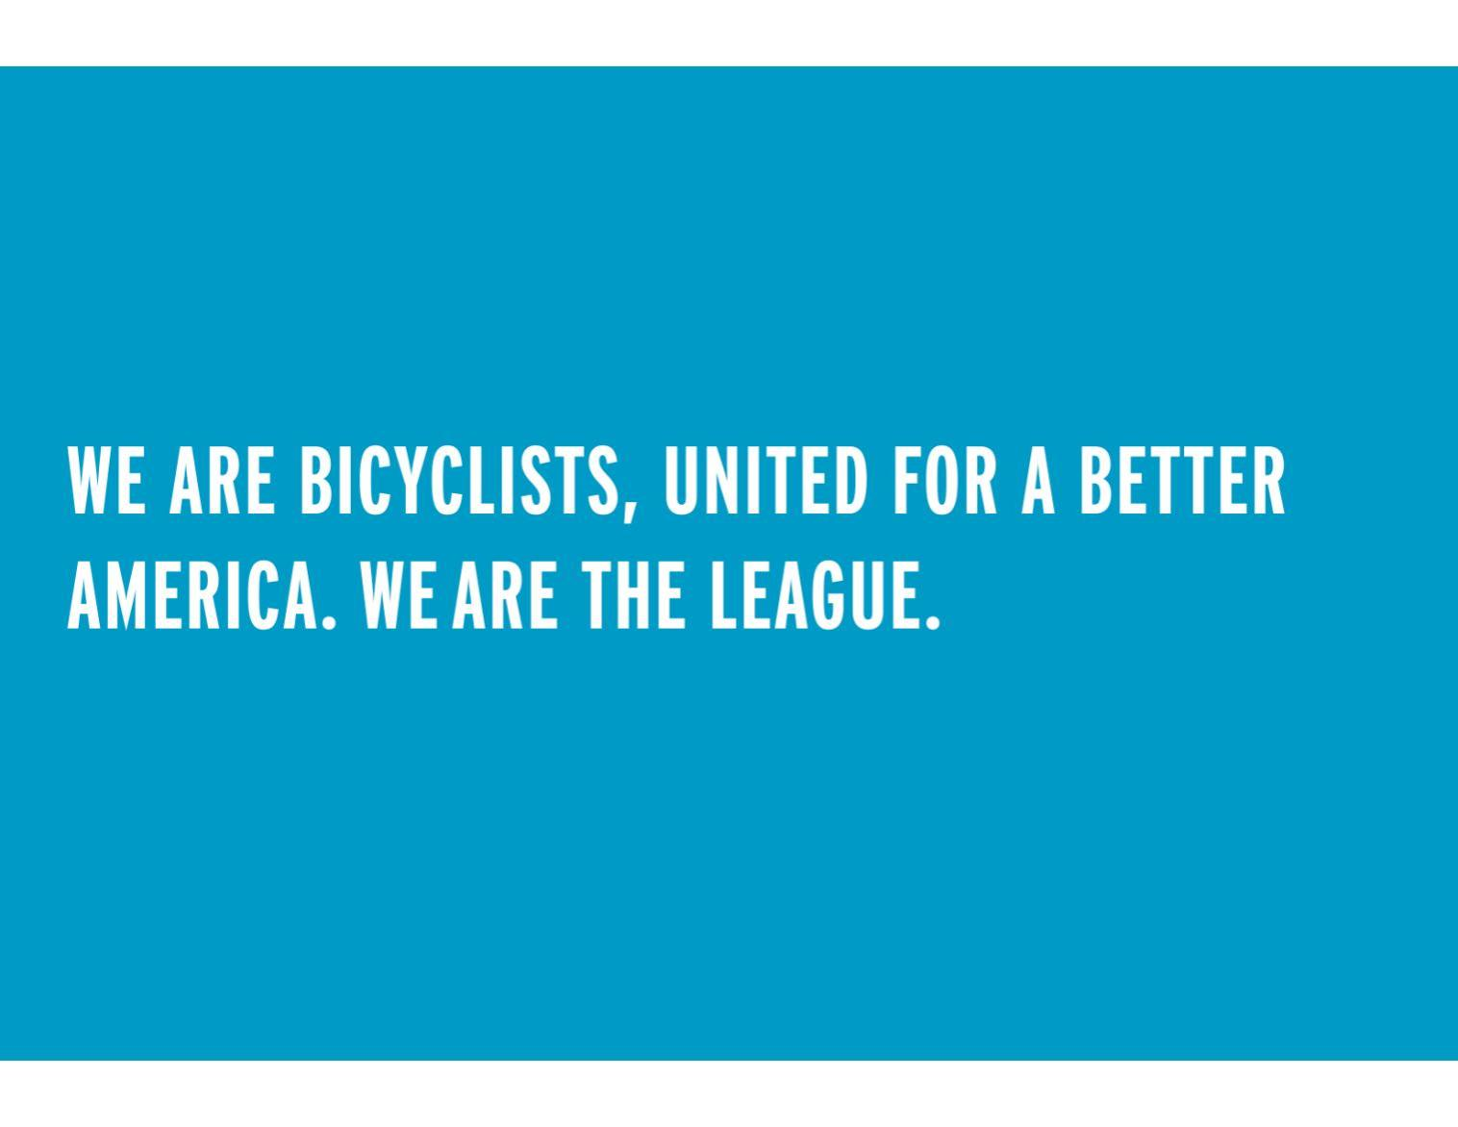
Notes:
As host of the National Bike Summit, the League takes a leadership role in bringing the interests of people who ride bikes to Congress and the Federal government. We empower our state and local affiliates to advocate effectively on issues that affect cyclists.
The League’s Bicycle Friendly America program provides the blueprint and a host of technical resources and best practices for communities, businesses, universities and states seeking to encourage bicycle use and improve traffic safety.
Our Smart Cycling program is the only national certification program for bicycle safety instructors; the Traffic Skills 101 curriculum is the basis for virtually all state and local bicyclist education programs.
National Bike Month (May) and Bike to Work Day are firmly established on the cycling calendar as anchor events to promote riding, something which the League’s more than 900 affiliated local recreational clubs and advocacy groups embrace enthusiastically.
The National Bike Challenge inspires people to ride through friendly competition, rewards and community-building.

Slide 4





Notes:
The Bicycle Friendly America Program started in 2002 with the Bicycle Friendly Community program, which evaluates communities including cities, counties, townships, and metropolitan areas.
In 2008, the Bicycle Friendly Business (BFB) and Bicycle Friendly State (BFS) programs were added to the program, and in 2011 they introduced Bicycle Friendly University.
Today there are over 400 communities, over 1300 businesses, and 180 universities that have received a Bicycle Friendly designation from the League. Each year the League evaluates and ranks all 50 states.
All of the Bicycle Friendly America programs include evaluation, recognition and feedback.

Slide 5
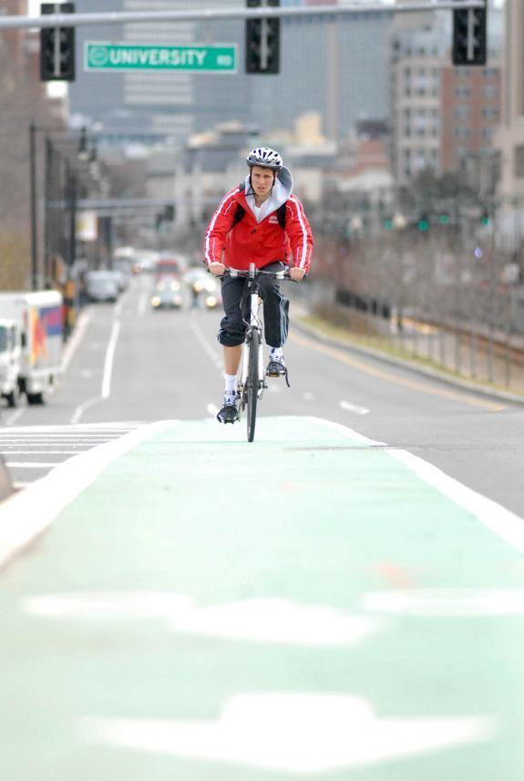
Providing a Roadmap for a Bicycle Friendly America
Setting targets and options for any place
Benchmarking
Facilitates partnership between advocates & decision makers
Hands-on assistance from staff
Award designation and media promotion
Notes:
The Bicycle Friendly America program provides a roadmap to transform states, communities, businesses and universities. The free online applications, resource libraries and hands-on assistance from program staff offer guidance in building truly bicycle-friendly places.

Slide 6
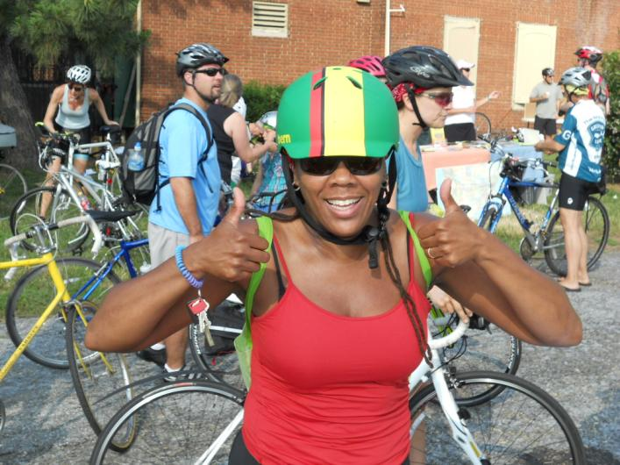
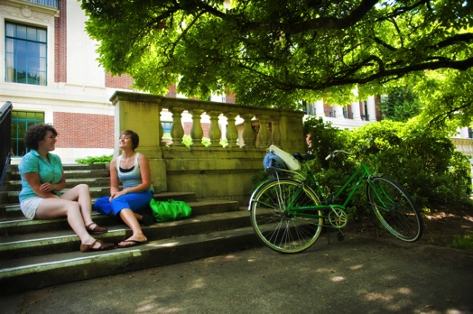
Bicycling: a simple solution
Quality of campus life
Reduced parking, transportation and healthcare costs
Congestion reduction
Sustainability
Improved health, happiness and productivity
Notes:
It is important to say that all of this is not a special interest. Creating more opportunities for bicycling is a simple solution to many of the challenges we face as a nation – from improving personal and environmental health, to building vibrant and robust local economies. It makes a lot of sense to build bicycle-friendly campuses as well – from reducing the costs of parking, congestion, transportation and healthcare to improving sustainability and overall campus quality of life.
Bicycle Friendly Universities are on the lists of the top colleges and universities to study. These are the types of campuses students and staff are drawn to.

Slide 7
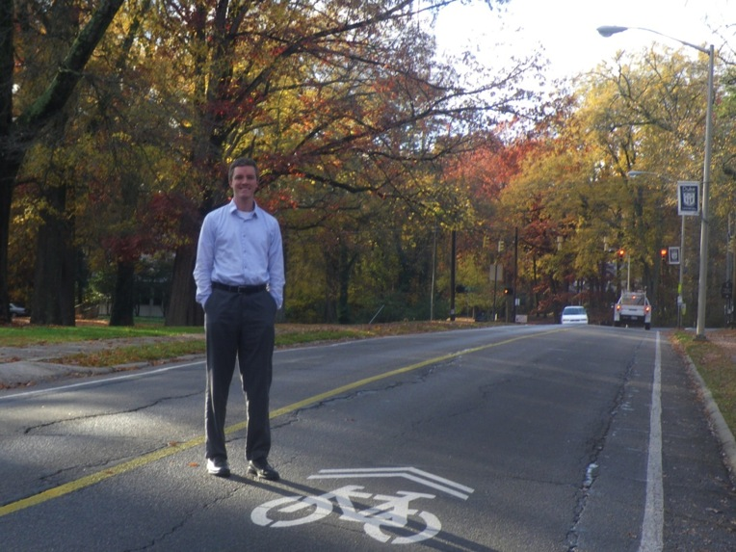
Bicycling: a simple solution
“Being able to say to the university, ‘For less than the cost of one deck-parking space, we were able to make all of the roads on campus more bicycle friendly’ was huge.”
- Brian Williams, Duke University (Bronze)
Notes:
Duke University has used the program as a tool to creating a more safe and accessible campus for bikes and is saving money at the same time! After receiving feedback with their first honorable mention, transportation staff went out and accessed every roadway in the campus and determined which would get bike lanes and shared lane markings.
“Being able to say to the university, ‘For less than the cost of one deck-parking space, we were able to make all of the roads on campus more bicycle friendly’ was huge.” - Brian Williams, Duke University (Bronze)

Slide 8
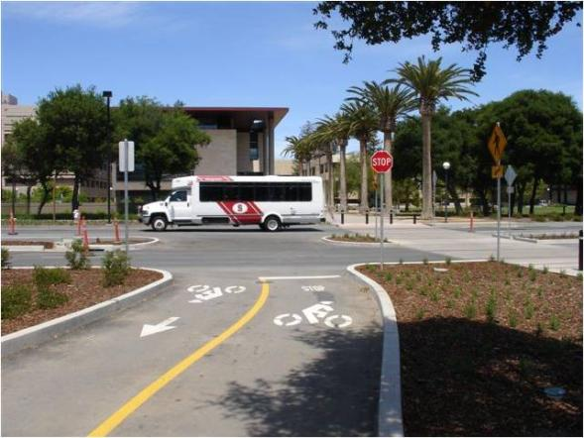

Stanford Example
Offered students and staff “Clean Air Cash” $90/year not to drive
Raised the cost of parking by 15%
Invested $4 million in bike facilities
Saved $18 million on (not) building car parking
promotes bicycling for fun, fitness and transportation, and work through advocacy and education for a bicycle-friendly America.
Notes:
Stanford offered further incentive by raising parking prices 15 percent. Then, it invested $4 million in bicycle facilities, including turning a main road through campus into a bike and transit mall. This $4 million enticed 900 people out of their cars and onto bicycles, according to a case study in Transportation & Sustainable Campus Communities, by Will Toor and Spenser Havlick. Building parking facilities to accommodate those 900 people would have cost $18 million.

Slide 9
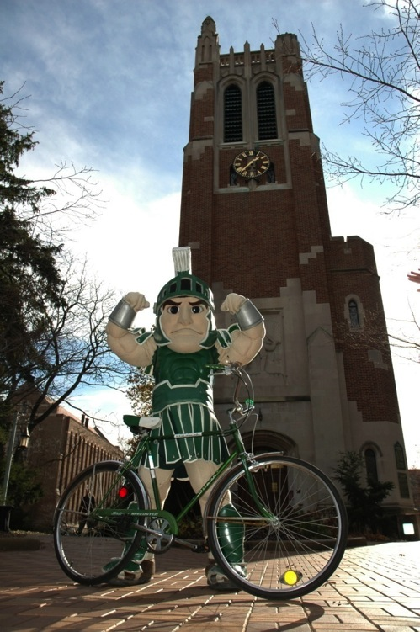
What is the bfu program?
Four Award levels
Platinum
Gold
Silver
Bronze
Program recognizes colleges and universities for bicycle friendliness and provides roadmap and assistance to become better.
Notes:
The League has run a BFU program since 2011
It is based on an online application that can be submitted for review once per year.
The program has four award levels from Bronze through Platinum
At its core the BFU program provides recognition and a roadmap for building strong campuses for cycling.

Slide 10
Who is eligible?
All Higher Ed Institutions with a physical presence:
…one application per campus
Public University
Private University
Liberal Arts College
Baccalaureate College
Technical College
Community College
Career College
Urban Campus
Suburban Campus
Rural Campus
Commuter Campus
Satellite Campus
Etc.

Slide 11
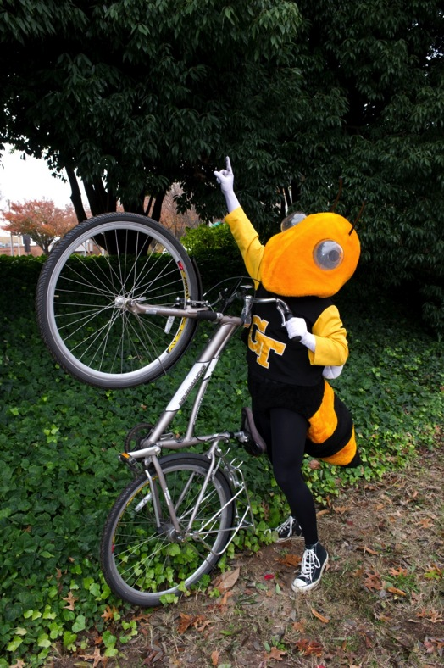
Application criteria
Engineering
Education
Encouragement
Enforcement
Evaluation & Planning
Online application
bikeleague.org/university
Notes:
The online application form asks a series of about a dozen questions in each of five major areas of bicycle policy and programs. The application provides a menu of options for any college or university to better welcome and accommodate bicycling. Institutions are encouraged to provide the most comprehensive approach to making bicycling a more comfortable and convenient option for students, faculty and staff. To reach the higher levels of BFU designation, applicants must score well across all five areas.
The five E’s are:
1. Engineering: Physical infrastructure and hardware to support cycling
2. Education: Programs that ensure the safety, comfort and convenience of cyclists and fellow road users
3. Encouragement: Incentives, promotions and opportunities that inspire and enable people to ride
4. Enforcement: Equitable laws and programs that ensure motorists and cyclists are held accountable
5. Evaluation: Processes that demonstrate a commitment to measuring results and planning for the future

Slide 12
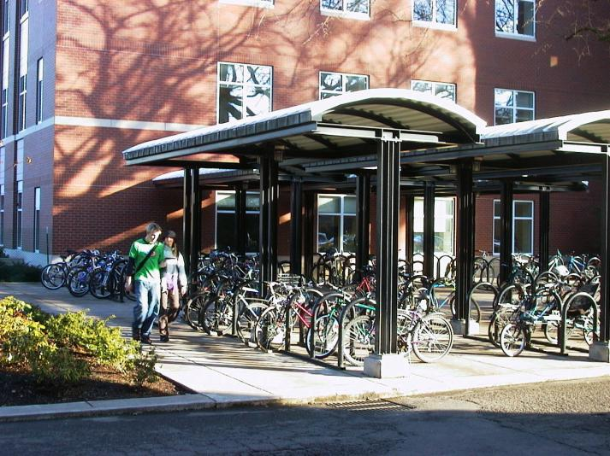
Engineering
Bike parking
- covered, secure
- bike lockers
- bike station
- bike valet
On campus parking permits, faculty and students
- extra cost
Connectivity & traffic calming
promotes bicycling for fun, fitness and transportation, and work through advocacy and education for a bicycle-friendly America.
Portland State University

Slide 13
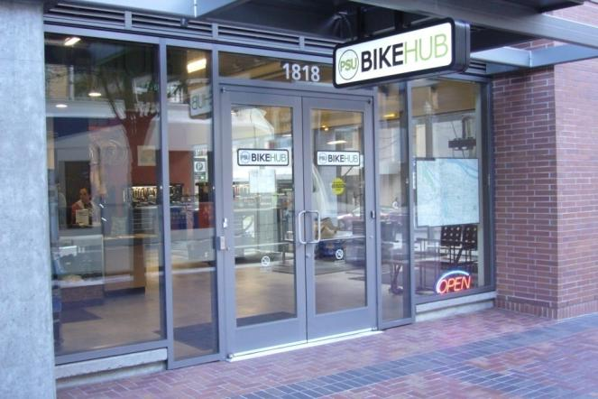
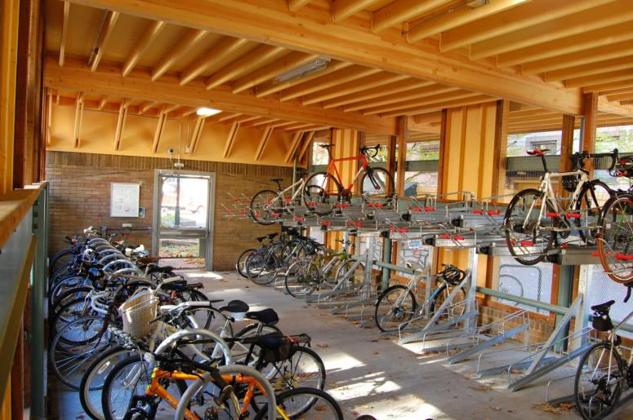
Engineering
Bike Parking PLUS
promotes bicycling for fun, fitness and transportation, and work through advocacy and education for a bicycle-friendly America.
Portland State University’s
Bike Hub

Slide 14
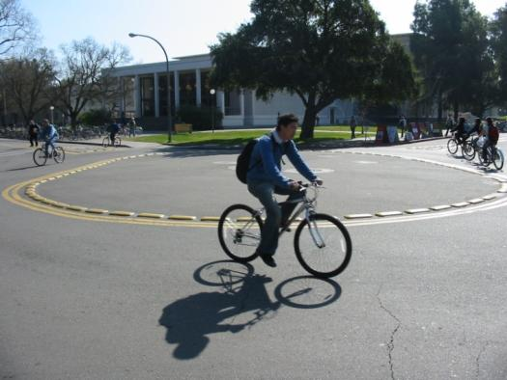
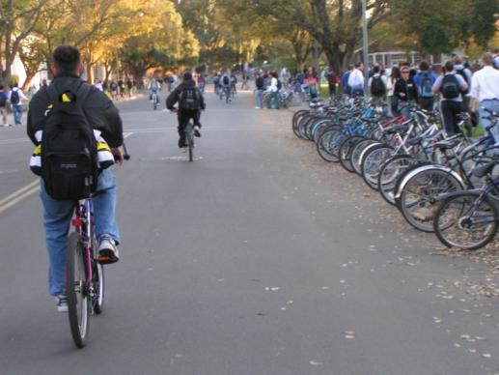
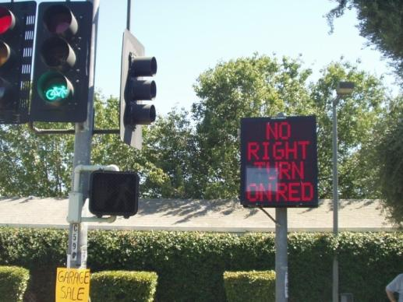
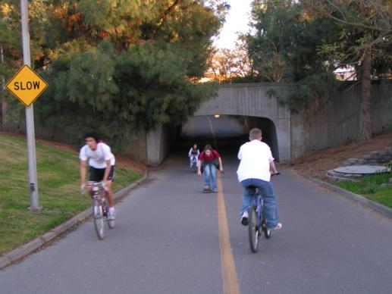
Engineering
promotes bicycling for fun, fitness and transportation, and work through advocacy and education for a bicycle-friendly America.
UC Davis
Notes:
Davis has always been a great example of a bicycle-friendly college town especially in the seamless network and innovative facilities for all types of trips and riders

Slide 15
Engineering: Cost of parking
Cost to purchase and install bike racks: $150 to 300 each (parks two bikes)
Cost to purchase and install bike lockers: $1000 to $4000 each (parks two bikes)
Cost to provide car parking space: $2200 surface lot, $12,500 garage
Number of bike spaces in one car space: 10–12
promotes bicycling for fun, fitness and transportation, and work through advocacy and education for a bicycle-friendly America.

Slide 16


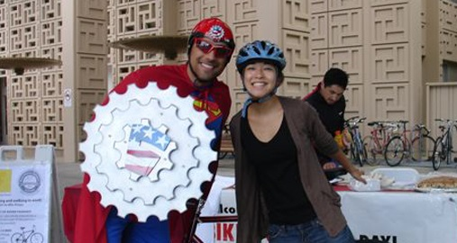
Education
Ongoing education campaign
Orientation for incoming students and employees
Motorist training for professional drivers
Diversion program
Events
Materials – print and online
University of Illinois
Stanford University

Slide 17
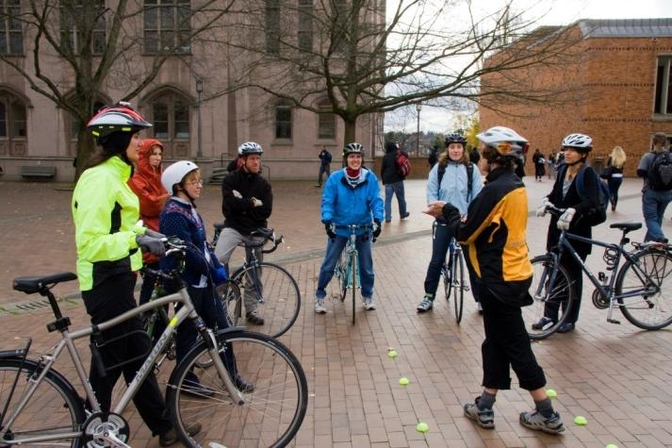
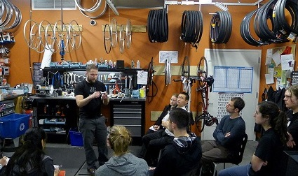
EDUCATION
Traffic Skills 101
Commuting
Bicycling Skills
LCI Seminar
bikeleague.org/ridesmart
Maintenance classes
Academic courses
- bike/ped planning
- public health
- physical education
Washington State University
Portland State University

Slide 18
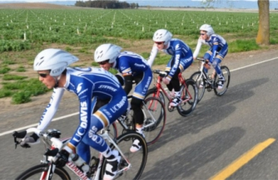
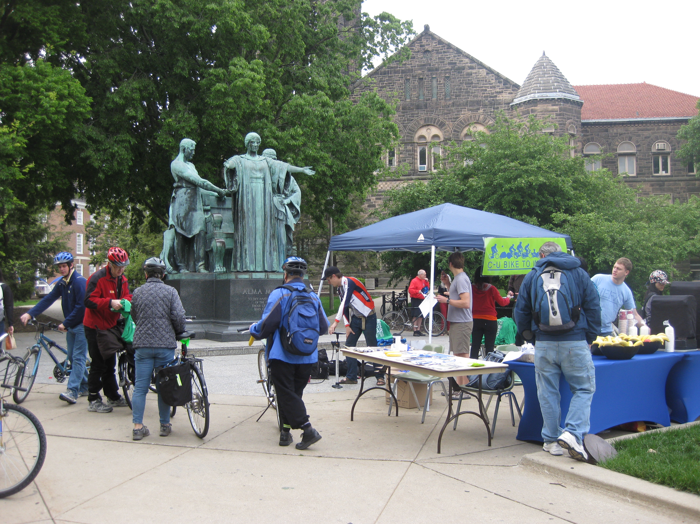
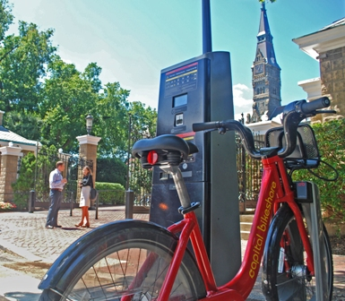
Encouragement
Bike sharing/rental/loan system
Student groups, clubs and teams
Events
Recreational facilities
Bicycle maps
UC Davis
University of Illinois
Georgetown University

Slide 19
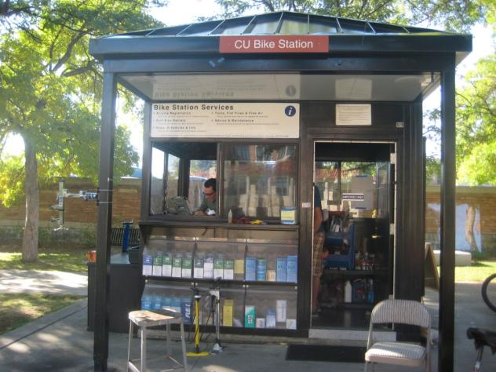
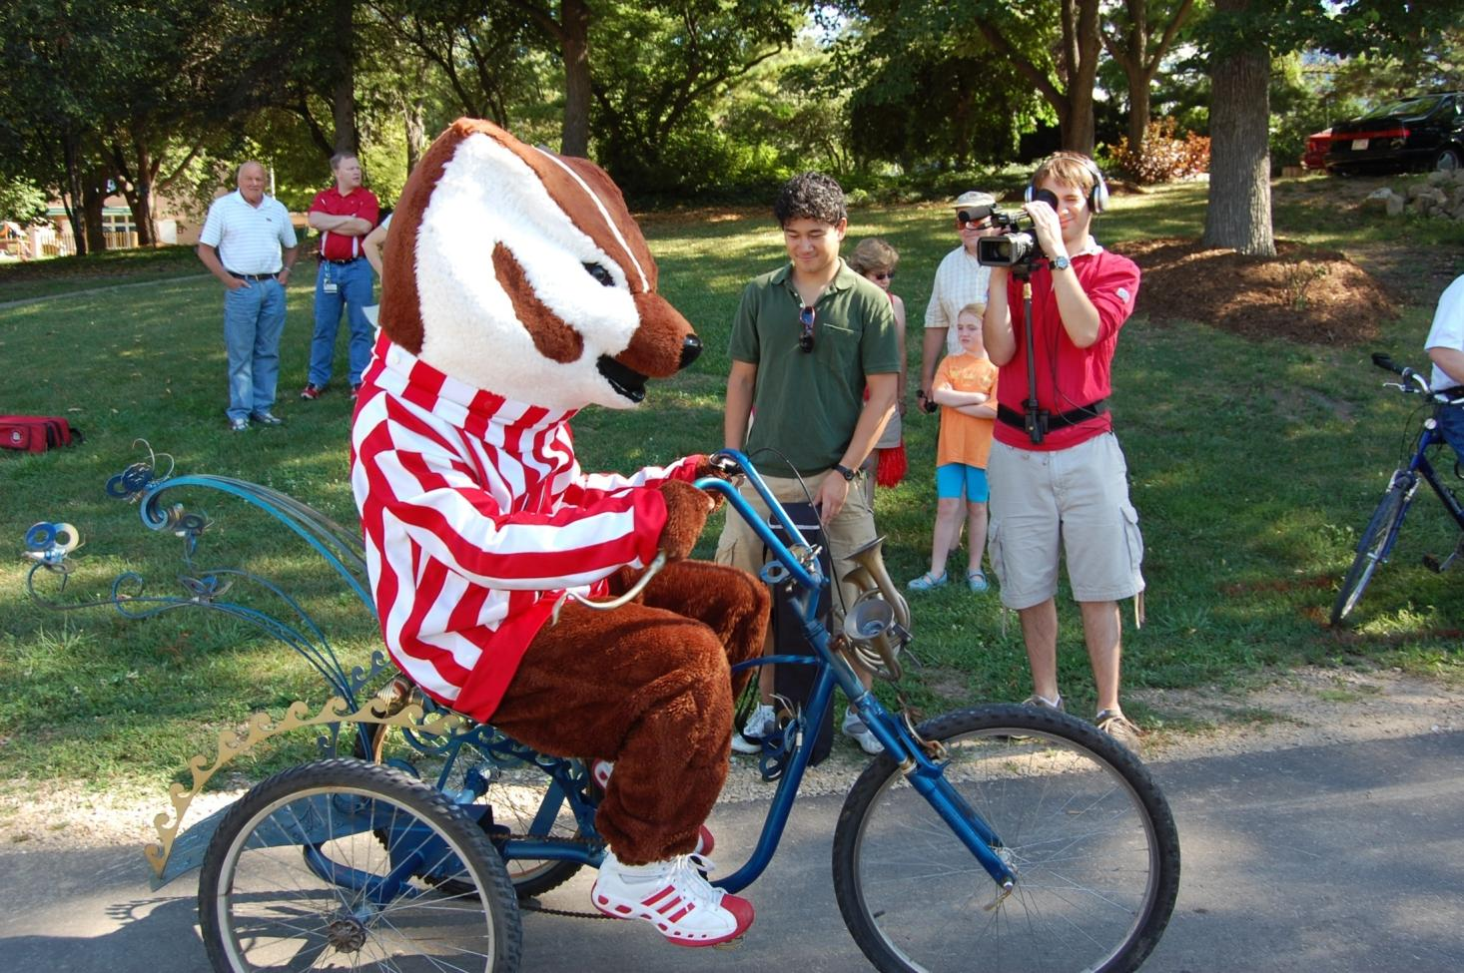
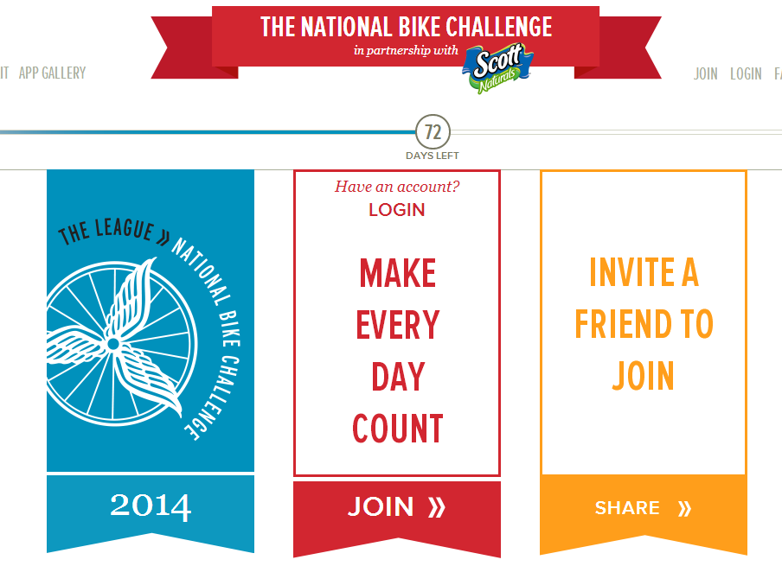
Encouragement
Commuter incentive program
National Bike Challenge
On-campus Bike Center
promotes bicycling for fun, fitness and transportation, and work through advocacy and education for a bicycle-friendly America.
University of Colorado, Boulder
University of Wisconsin, Madison
National Bike Challenge

Slide 20

enforcement
Bike Registration
Bike theft prevention
Campus police on bikes
Bike safety
Targeted enforcement
Helmet & light giveaways
Equitable policies for bicycles
promotes bicycling for fun, fitness and transportation, and work through advocacy and education for a bicycle-friendly America.
Stanford University

Slide 21
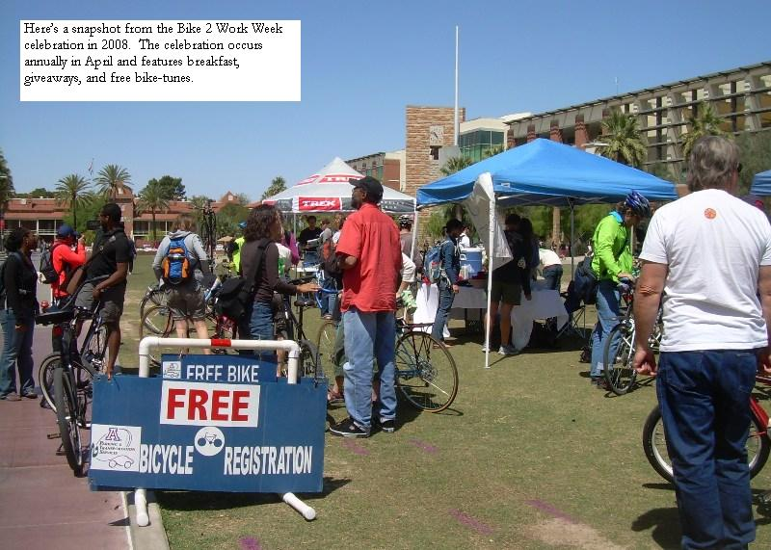
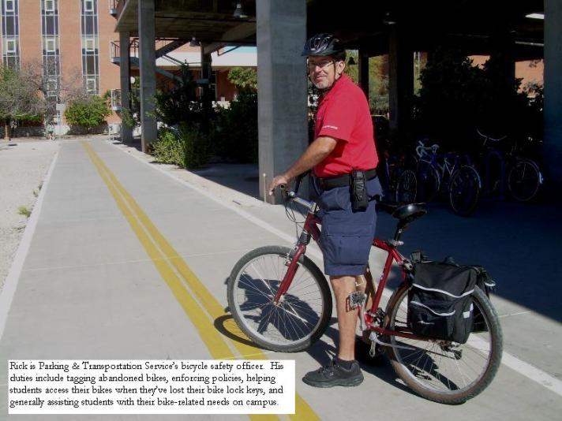
enforcement
University of Arizona

Slide 22
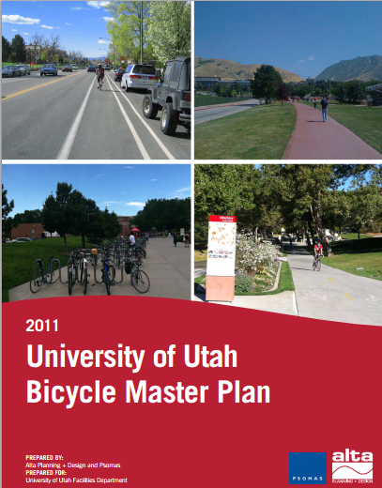
Evaluation & planning
Comprehensive Bicycle Master Plan
Staff time on bicycle initiatives
Bicycle Advisory Committee
Bicycle counts, data collection
Crash analysis & reduction
Satisfaction survey
Dedicated funding
promotes bicycling for fun, fitness and transportation, and work through advocacy and education for a bicycle-friendly America.

Slide 23
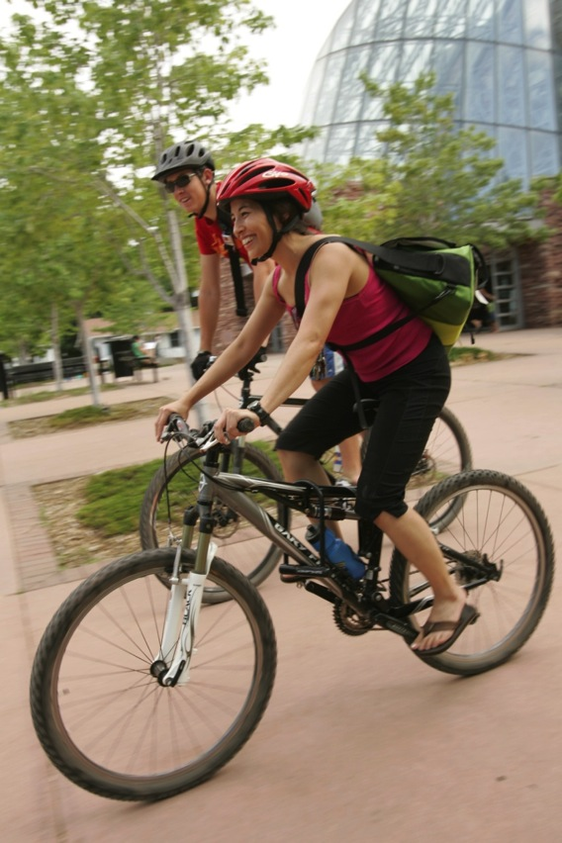
Application review
Applications received and reviewed by league staff
Input received from local cyclists, students, employees, and bicycle advocates
Notes:
The League has received over 200 applications and designated over 180 BFUs in 45 states and Washington, DC.
After a college or university submits the application and sends any appropriate supporting literature, the application is reviewed two ways:
League staff review the applications internally
Local cyclists – League members, staff, students, LCIs, shop owners, advocacy group leaders, club leaders etc., are asked to comment on the application and provide their perspective on the bicycle-friendliness of the campus.
This last stage of the review is important to us, and local reviewers have definitely had an impact on many of the awards – or lack of awards. All feedback received by local reviewers are incorporated (anonymously) into the final feedback report given to the college or university.

Slide 24
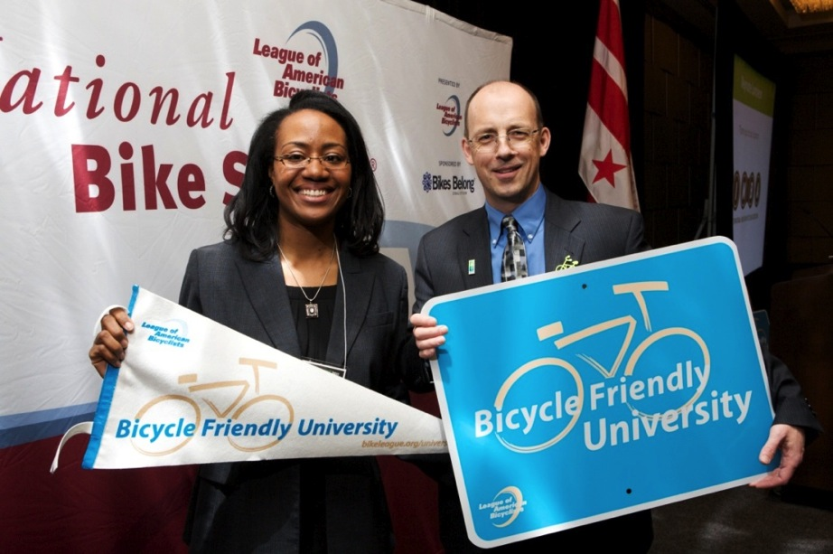
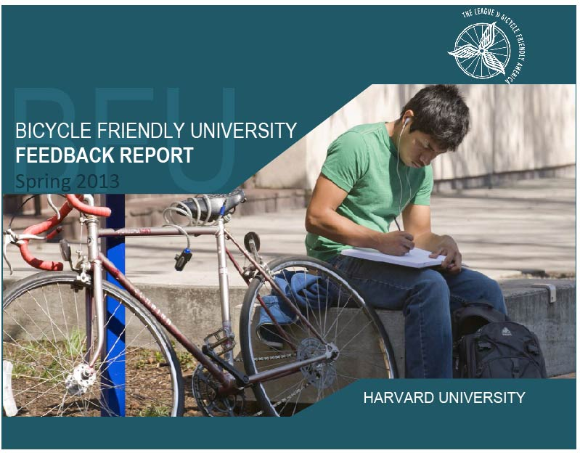
Benefits of applying
Feedback
Benchmarking
Coordination
of efforts
Recognition
Notes:
Over and over, we hear how useful the program is for coordination, benchmarking and giving the deserved recognition to all of the people – administration, students, faculty, staff and advocates– for building a great bicycle-friendly university.
Every campus that applies—whether they receive the BFU designation or not—will receive a detailed feedback report for the League outlining the ways in which they can improve.

Slide 25
Get started
Go to: bikeleague.org/university
Review the application and resources yourself to see how bicycle-friendly your university is today
Coordinate with your local bicycle advocacy group and contact staff for assistance
Notes:
The first step in the process is usually visiting bikeleague.org/university and checking out what BFUs are doing, review the online resource library and application and use the quick BFU Scorecard to do a quick assessment of your campus.
Your local advocacy group and bike clubs should be brought into the discussion of applying and of course, working to build a stronger bicycle-friendly campus.
There is a $100 Application Fee

Slide 26
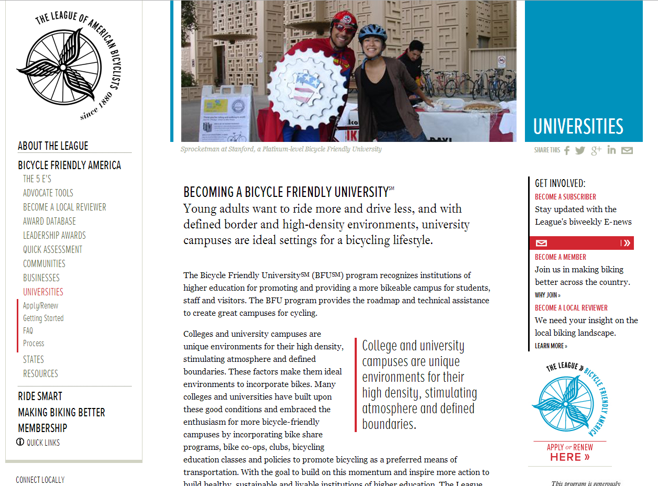
Online resource library
Notes:
The League’s online resources include best practices and success stories from colleges and universities of all shapes and sizes from every region of the country. The League’s Bicycle Friendly America program staff are available to answer your questions and help you through the process.

Slide 27
[Insert contact info]
Notes:
Thank you.
[Take questions. For answers on more detailed questions ask them to consult the website or contact the League.]

Slide 28

THANK YOU!

