Slide 1

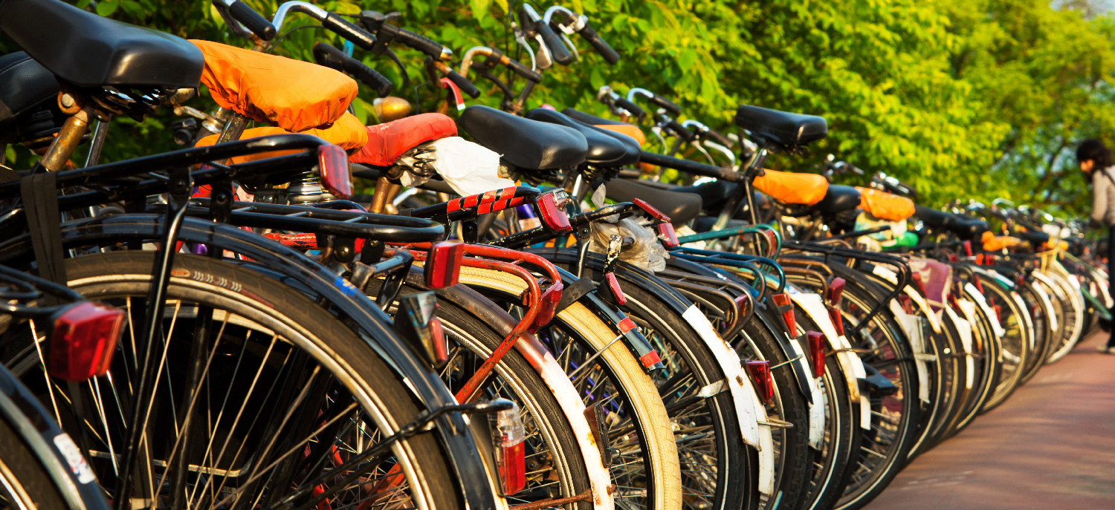
Creating a bicycle friendly community
[Insert name, affiliation and date]
Notes:
[Thank your audience for coming and introduce yourself.]
The Bicycle Friendly Community program is a program of the League of American Bicyclists and I am here to assist to get the most out of the program.

Slide 2

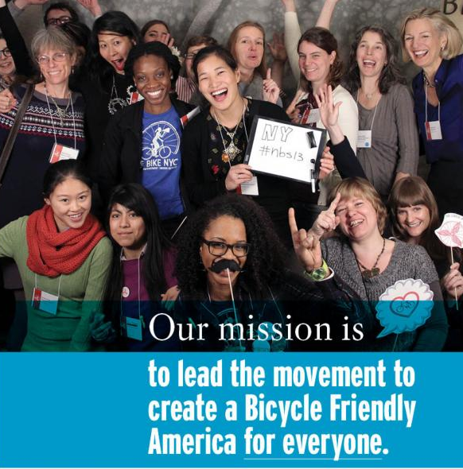
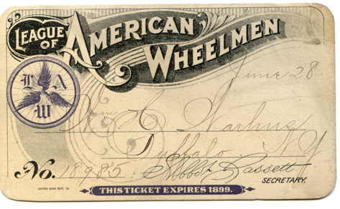
ABOUT THE LEAGUE
Notes:
The League was founded in 1880 and had big wins early to get the first paved roads for bicyclists. Today, the League continues to make biking better. Its mission is to lead the movement to create a Bicycle Friendly America for everyone. As leaders, the League’s commitment is to listen and learn, define standards and share best practices to engage diverse communities and build a powerful, unified voice for change.

Slide 3
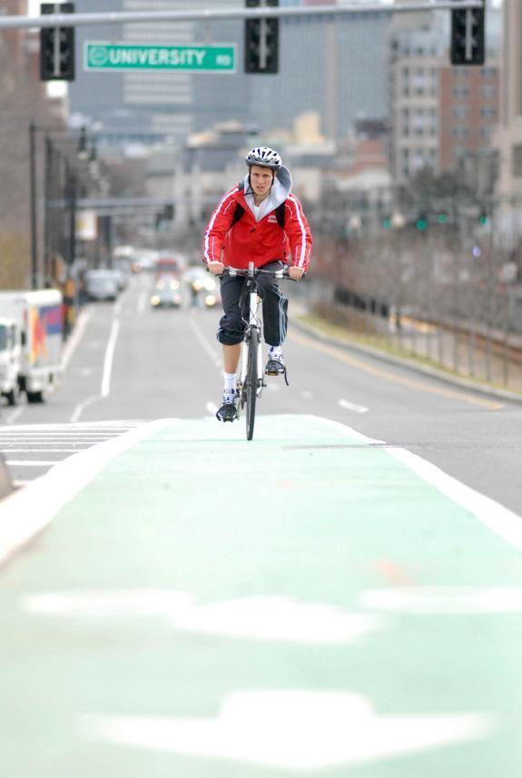
Providing a Roadmap for a Bicycle Friendly America
Setting targets and options for any place
Benchmarking
Facilitates partnership between advocates & decision makers
Hands-on assistance from staff
Award designation and media promotion
Notes:
The Bicycle Friendly America program is a key component of the League. At all times it is meant to be a positive tool – it is provides a roadmap to transform states, communities, businesses and universities. Each program provides a broad menu of options for taking action through the free online applications, resource libraries and hands-on assistance from program staff..

Slide 4
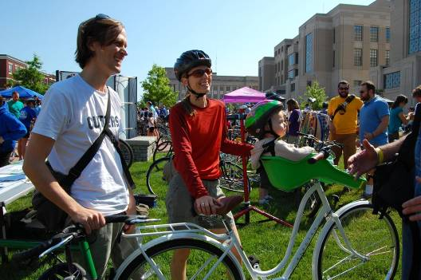
Where people want to live, work, and visit
BFCs always on best places to live, work, study and retire lists. (6 in US News’ latest Top 10)
Mercer Int’l Quality of Life Ranking: 7 of 8 U.S. cities are BFCs
Forbes – Healthiest Cities : 15 of top 20 are BFCs
Businessweek Best Places to Ride out the Recession 17 of 20 are BFCs
Notes:
It is important to say that all of this is not a special interest. Creating more opportunities for bicycling is a simple solution to many of the challenges we face as a nation – from improving personal and environmental health, to building vibrant and robust local economies.
Bicycle Friendly Communities always top the lists of best places to live, work, visit, retire and study from Forbes and Newsweek to the international rankings of city quality of life. In addition, these cities have been recognized for their economic sustainability through the recession. Businessweek - top 20 cities to ride out a recession, 17 are BFCs.

Slide 5
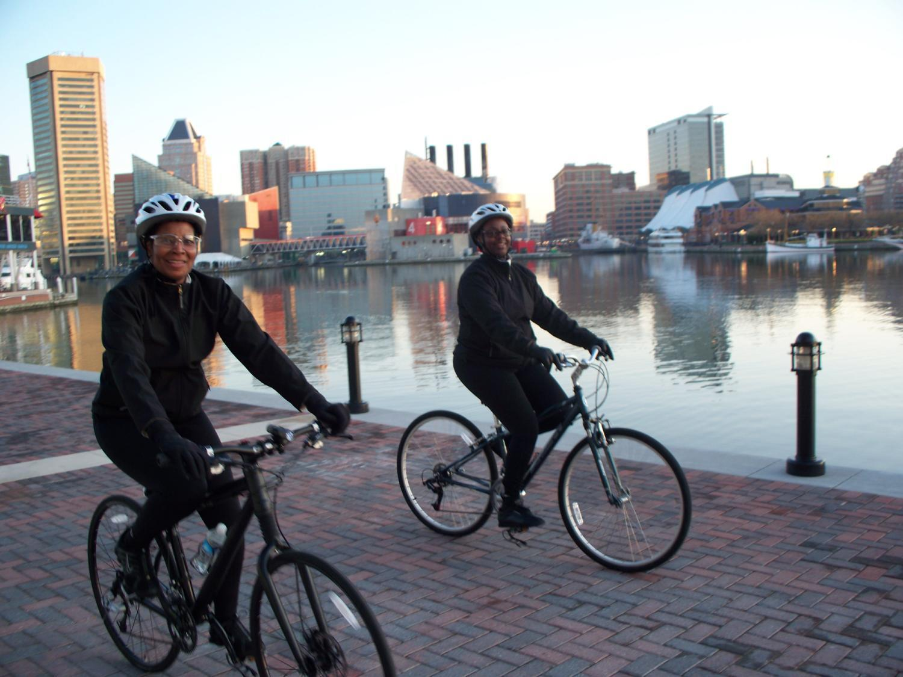
Notes:
And a big part of their high quality of life comes with making bicycling an easier, more comfortable option for people to get to where they want to go or recreate by bike. It works and the proof is in cities across the country.
(Photo: Baltimore - Bronze BFC where bicycle commuting has doubled in the last 10 years)

Slide 6
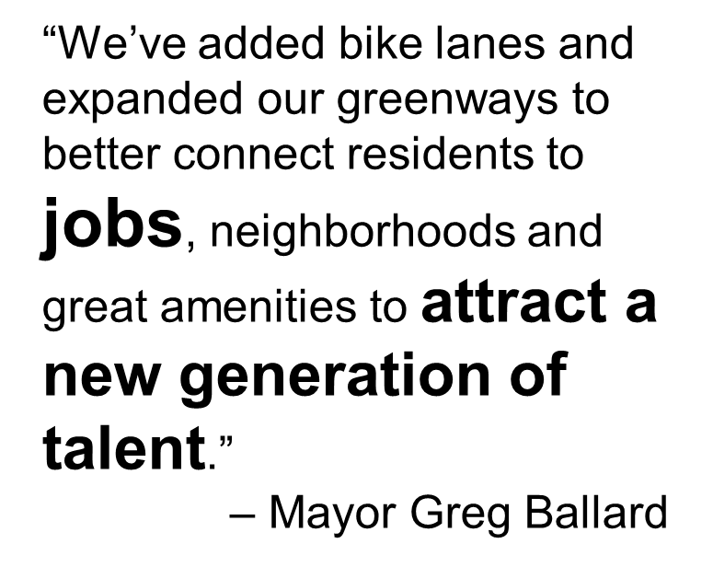
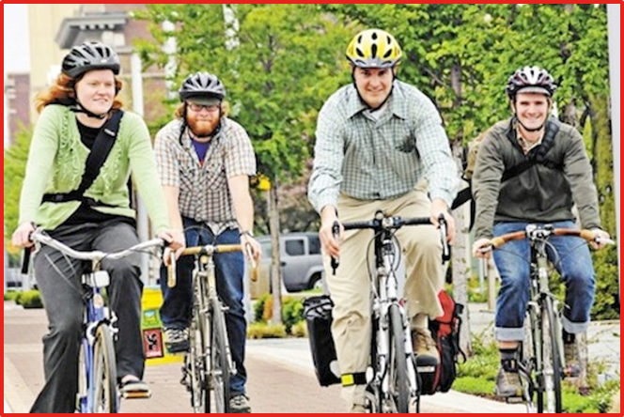
Smart leaders are answering the demand
Indianapolis, IN
Photo: Mark Lee
Notes:
Bicycling is more than a practical, cost-effective solution to many municipal challenges. It’s an opportunity to make your community a vibrant destination for residents and visitors — a place where people don’t just live and work, but thrive.
Community leaders like Mayor Ballard from Indianapolis see building a Bicycle Friendly Community as a way to attract and keep talented people.

Slide 7
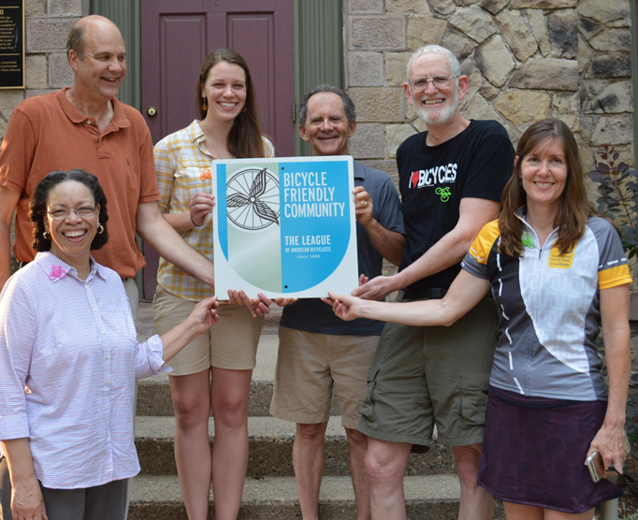
What is the bfc program
Started in 1996 with the BFC program
Updated program in 2002
5 Award levels: Diamond, Platinum, Gold, Silver and Bronze
+Honorable Mention category.
Program recognizes communities for bicycle friendliness and provides roadmap and assistance to become better
Notes:
The League has run a BFC program for 10 years– at first in the 1990s with relatively easy criteria for communities to meet.
In 2002 the program was overhauled and a new, more rigorous application and review process was initiated. One important change was the creation of a four tiered award system – created with the intent of encouraging communities to continually improve. A fifth award level – Diamond – was added in 2012.
(Photo: Lambertville, NJ - Bronze BFC)

Slide 8
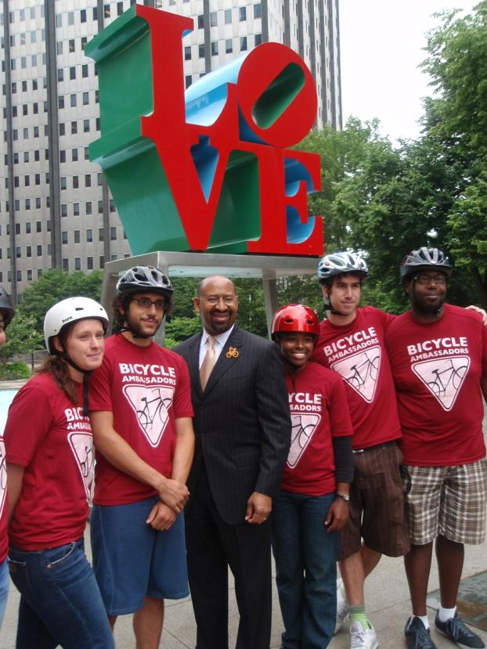
Application criteria
Engineering
Education
Encouragement
Evaluation & Planning
Equity
Online application
bikeleague.org/community
Notes:
The free, online application form asks a series of about a dozen questions in each of five major areas of bicycle policy and programs. The application provides a menu of options for any community to better welcome and accommodate bicycling. Communities are encouraged to provide the most comprehensive approach to making bicycling a more comfortable and convenient option for citizens. To reach the higher levels of BFC designation, communities must score well across all five areas.
The five E’s are:
1. Engineering: Physical infrastructure and hardware to support cycling
2. Education: Programs that ensure the safety, comfort and convenience of cyclists and fellow road users
3. Encouragement: Incentives, promotions and opportunities that inspire and enable people to ride
4. Evaluation: Processes that demonstrate a commitment to measuring results and planning for the future
5. Equity: Across all the other E sections, there is a constant emphasis on equity, to ensure that bicycling is safe, comfortable, and accessible to all.
Note that as of Fall 2020, enforcement-related questions are now included as a sub-topic under “Evaluation & Planning”.
(Photo: Philadelphia’s Mayor Nutter with city’s Bicycle Ambassadors)

Slide 9
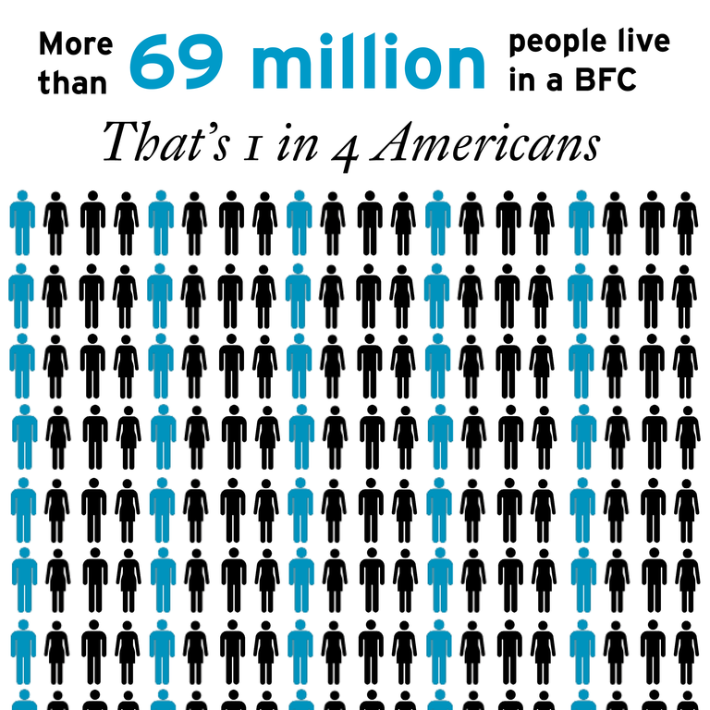
Application review
1,800+ applications
reviewed
League staff review data provided by communities
Optional public survey distributed by communities and to League members has collected over 50,000 responses since 2016
480+ BFCs in 50 states
Notes:
The League has received over 1,800 applications and designated over 480 BFCs in all 50 states and Washington, D.C.
After a community submits the application and sends any appropriate supporting literature, the application is reviewed three ways:
League staff review the applications internally, and
Local cyclists – League members, LCIs, shop owners, advocacy group leaders, club leaders etc., are asked to comment on the application and provide their perspective on the bicycle-friendliness of the community.
This last stage of the review is important to us, and local reviewers have definitely had an impact on many of the awards – or lack of awards.

Slide 10
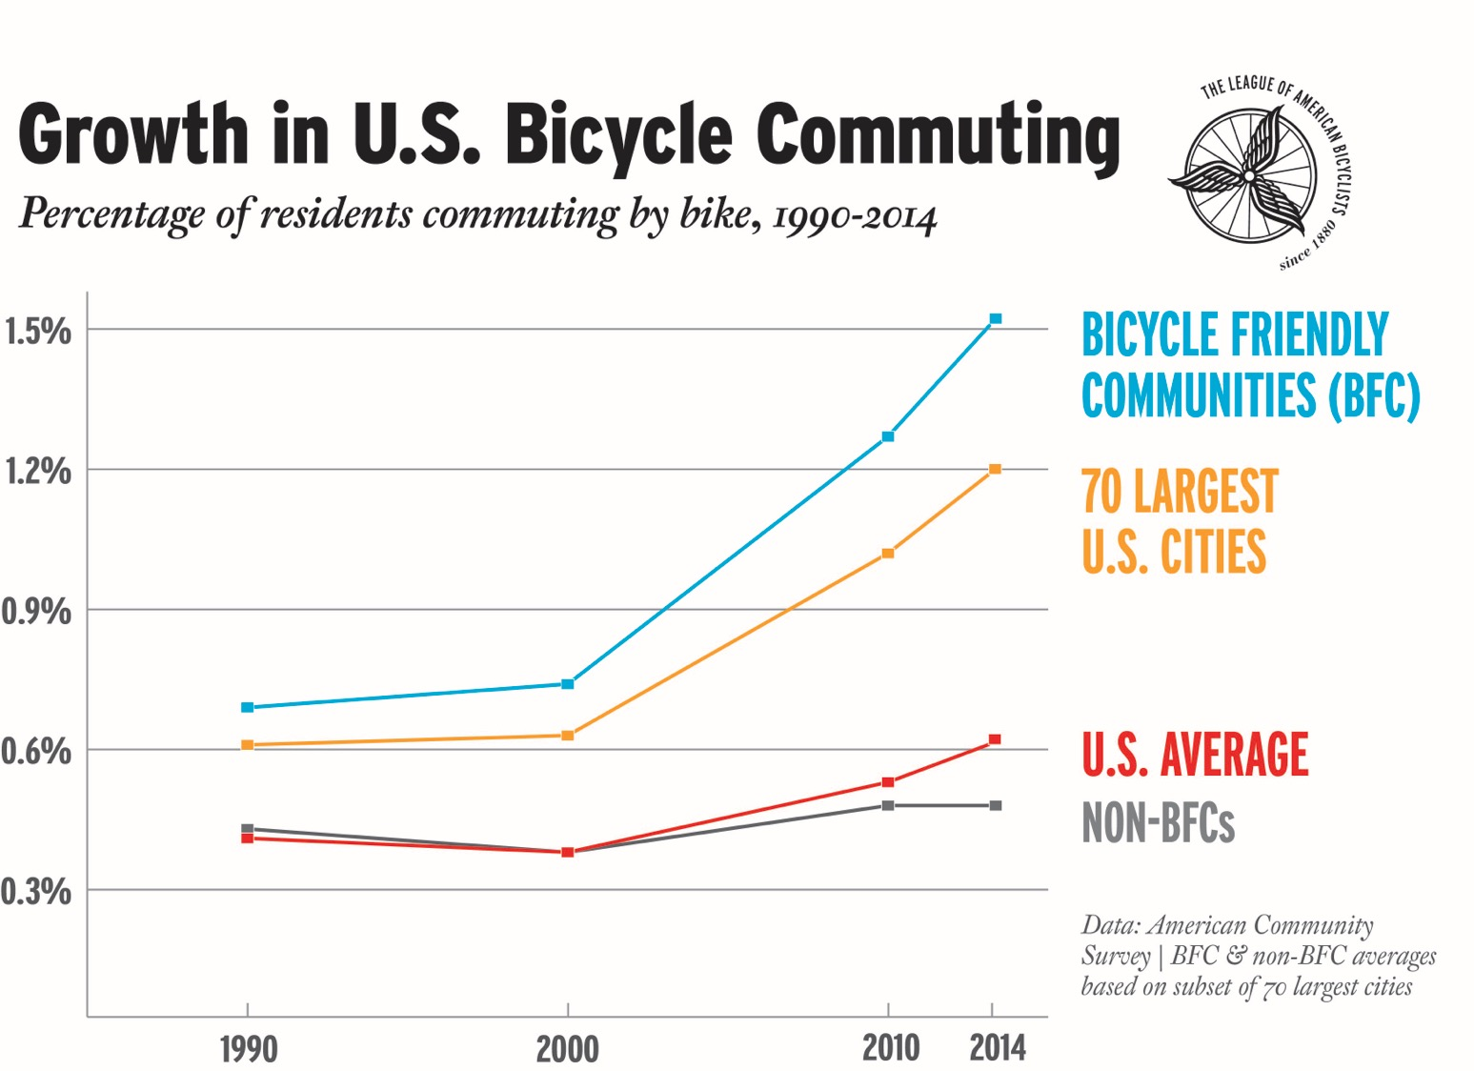
Notes:
Investing in bicycling works! Between 2000-2015 , the average American city has seen a 60% growth in bicycle commuting – Bicycle Friendly Communities have seen over 100% growth.
It’s not just in places like Portland, OR and Boulder, CO where this is happening. It’s happening in Baltimore, Indianapolis and Memphis as well.

Slide 11
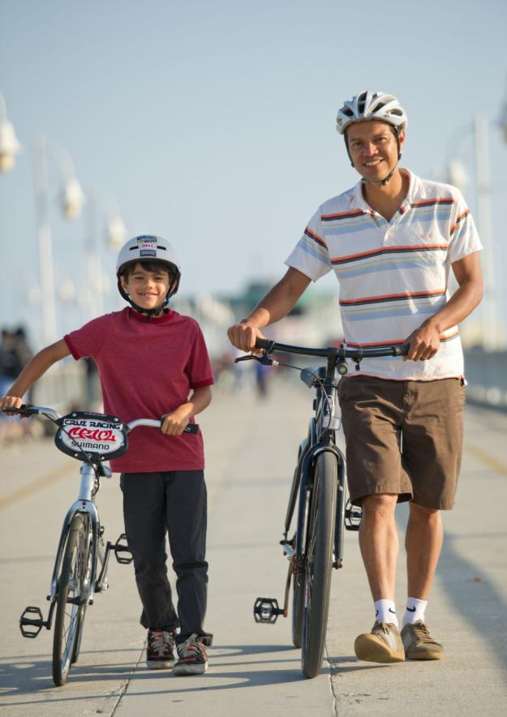
Benefits of applying
“We knew this recognition would be important to our civic and business leaders, and that the metrics set out in the League’s application would be important measures for us.”
- Allan Crawford, Bike Long Beach
Photo: Allan Crawford
Notes:
Over and over, we hear how useful the program is for coordination, benchmarking and giving the deserved recognition to all of the people – from civic and business leaders to advocates and educators – for building a great bicycle-friendly community.

Slide 12
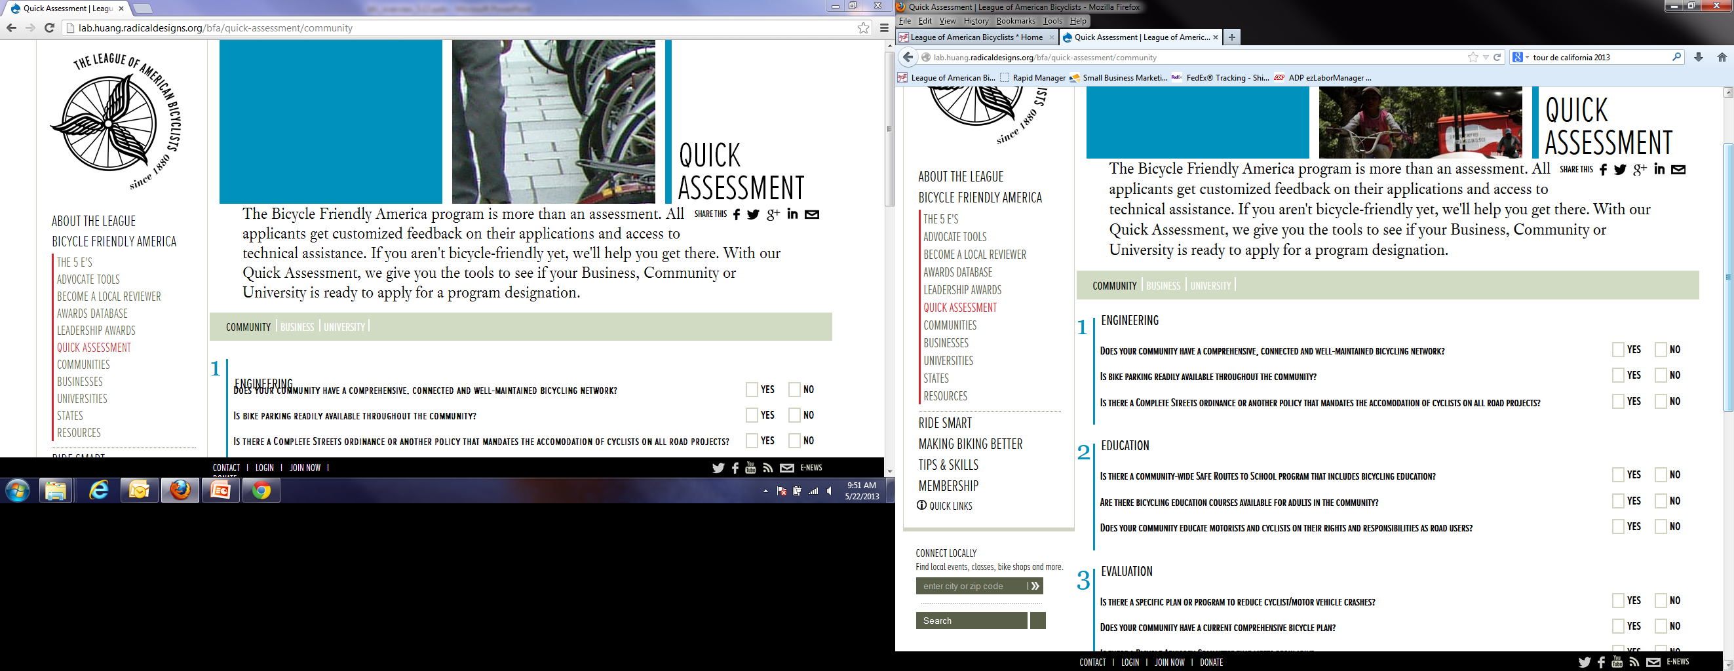
Get started
Visit bikeleague.org/community
Review Getting Started Guide
Use BFC Scorecard for self-assessment
Review the application and resources
Coordinate with your local bicycle group(s) and contact
staff for assistance
Notes:
The first step in the process is usually visiting bikeleague.org/community and review the Getting Started guide, application and resources, and use the BFC Scorecard to do a quick assessment of your community.
Your local advocacy group(s) and bike club(s) should be brought into the discussion of applying and of course, working to build a stronger bicycle-friendly community.

Slide 13
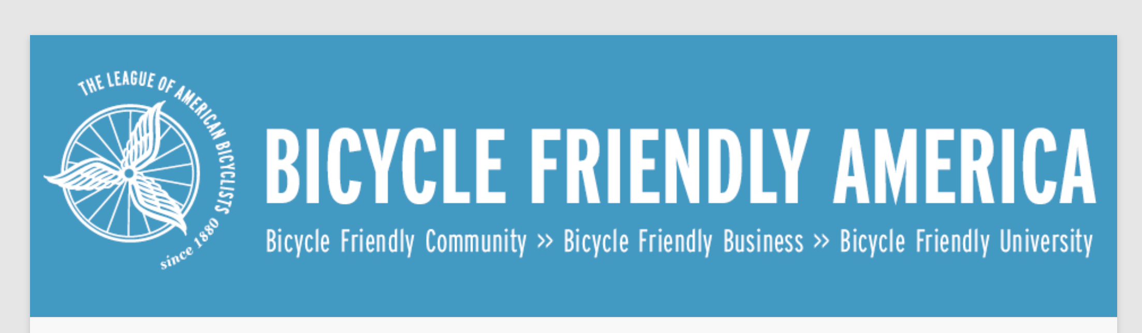
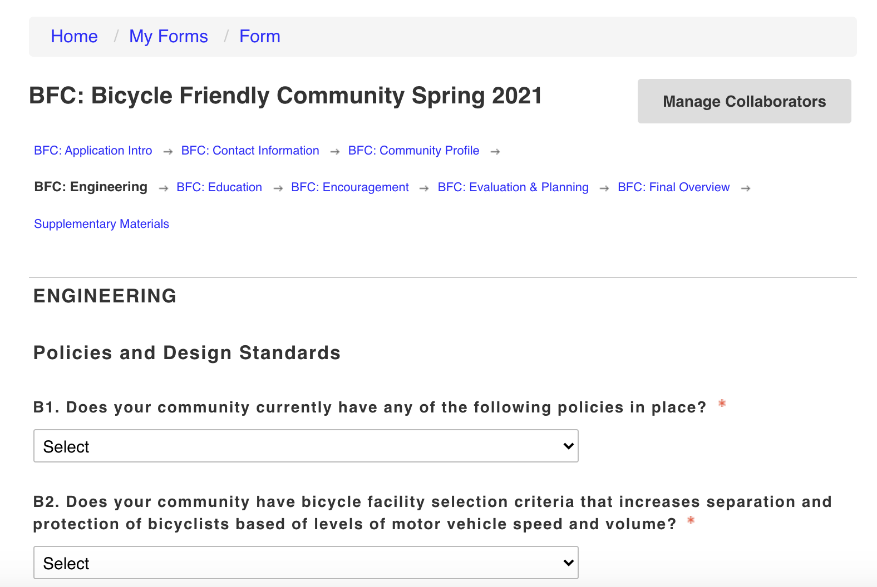
Online Application
Visit apply.bikeleague.org
Notes:
Once your community is ready to apply, there is a user-friendly online application open year-round, at apply.bikeleague.org. The online application contains questions divided by the ‘E Framework’, with additional fields to provide supporting documents by uploading supplementary files or URL links. Communities are welcome to start working on their application early and can save-and-return to the online form at any time.
The primary applicant will create an online account to begin the submission form, and they have the option to add other collaborators so that key stakeholders in the community can review and edit the application before it is submitted.
There are typically two deadlines per year, one in February and one in August, with awards announcements in May and November.
[Check https://bicyclefriendly.secure-platform.com/a/page/community/deadlines for a current list of upcoming deadlines to provide during your presentation.]

Slide 14
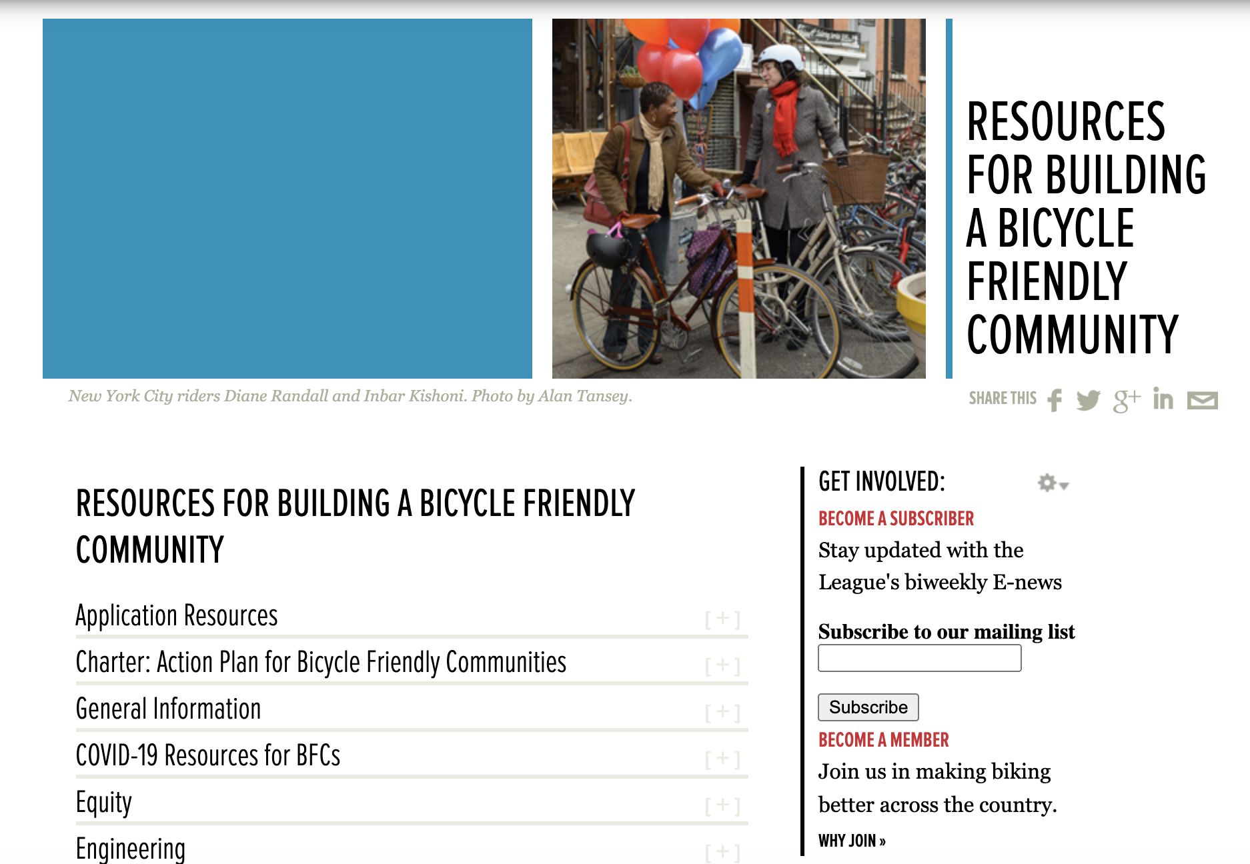
Online resource library
Visit bikeleague.org/BFC_Resources
Notes:
The League’s online resources include a growing directory of national standards, guides, best practices, and success stories from communities of all shapes and sizes from every region of the country. The League’s Bicycle Friendly America program staff are available to answer your questions and help you through the process.

Slide 15
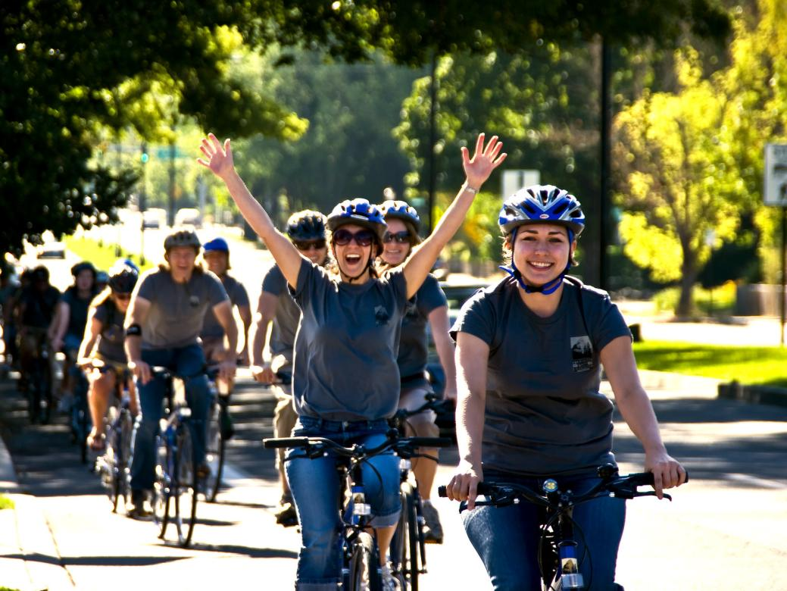
Bring the biking joy
Visit bikeleague.org/community
Notes:
Biking is fun, liberating and good for you and your community. Building a Bicycle Friendly Community is not rocket science. It is being done in small towns and big cities with the same great results – happy people and vibrant communities.

Slide 16
[Insert contact Info]
Notes:
Thank you.
[Take questions. For answers on more detailed questions ask them to consult the website or contact the League, at bfa@bikeleague.org.]

Slide 17
Thank you!
1612 K STREET, NW, SUITE 1102
WASHINGTON, DC 20006
202.822.1333 | @BIKELEAGUE
WWW.BIKELEAGUE.ORG

