Slide 1

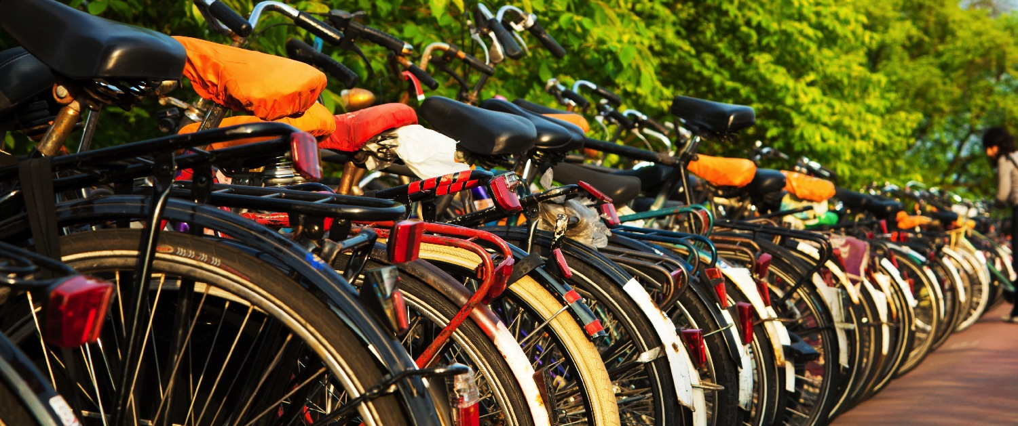
Creating a bicycle friendly business
[Insert name, affiliation and date]
Notes:
[Thank your audience for coming and introduce yourself.]
The Bicycle Friendly Business program is a program of the League of American Bicyclists and I am here to assist to get the most out of the program. The program will help you:
Improve your bottom line
Create healthier and happier employees
Reduce parking costs
And
Reduce healthcare costs
All by helping you
Prioritize, create and improve your transportation resources
Receive recognition for bicycle-friendly initiatives your business is makes.
Build a Bicycle Friendly Business through step by step guidelines.

Slide 2

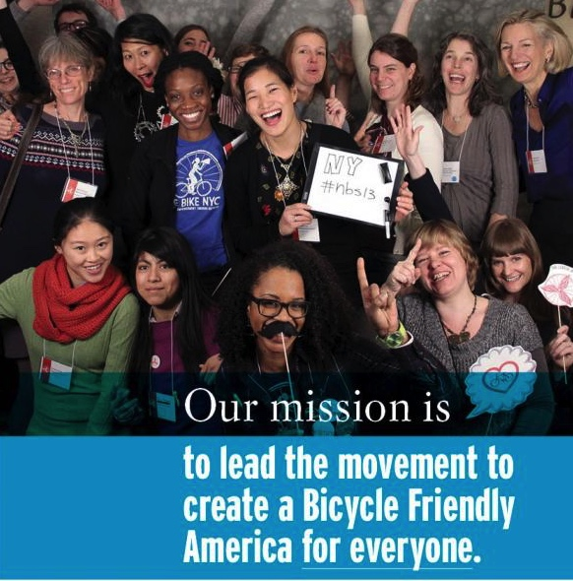
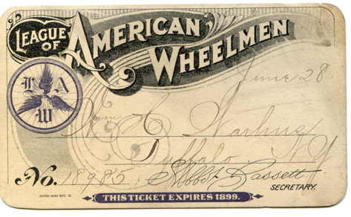
ABOUT THE LEAGUE
Notes:
The League was founded in 1880 and had big wins early to get the first paved roads for bicyclists. Today, the League continues to make biking better. Its mission is to promote bicycling for fun, fitness, and transportation through advocacy and education to build a bicycle-friendly America.

Slide 3





Notes:
The League has run the successful Bicycle Friendly Community program for several years. In 2008, the Bicycle Friendly Business (BFB) and Bicycle Friendly State (BFS) programs were added to the line-up, two years later they introduced Bicycle Friendly University (BFU).

Slide 4
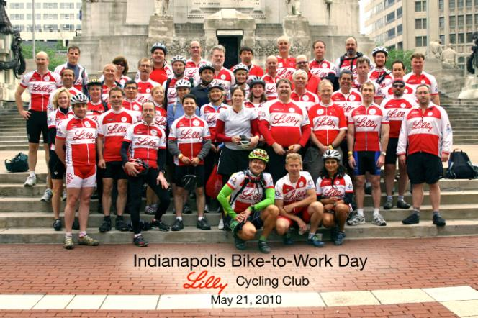
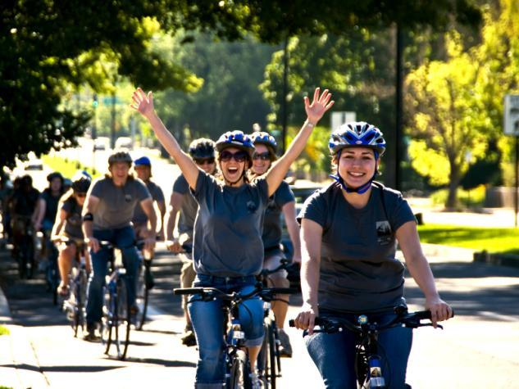
What is the BFB Program?
A program that recognizes businesses for efforts to encourage a more bicycle friendly atmosphere for employees, guests, and communities.
Notes:
Through the Bicycle Friendly Business program, the League recognizes businesses across the nation for efforts to encourage a more bicycle friendly atmosphere for employees, guests, and communities. The application is convenient, quick, and informative. It is housed and submitted on-line at bikeleague.org, the League makes it easy for businesses to apply.
The program not only offers recognition but also guidance and assistance to building a BFB.

Slide 5
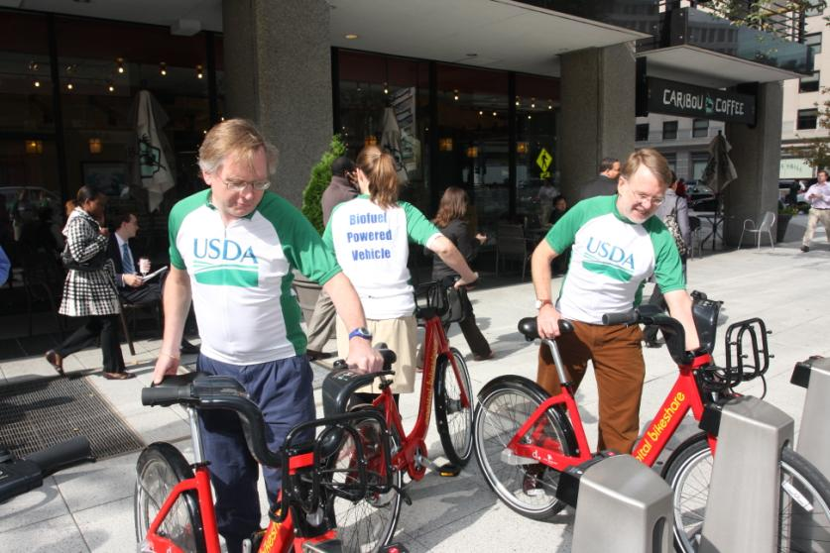
Eligible businesses
ANY
Business
Corporation
Organization
Non-profit
Government agency
No home offices or virtual offices.
Must have 2 or more regular visitors (employees, customers, volunteers, etc.)
1 location per application
Notes:
The League has made the program open to nearly all US businesses whether they be private sector, public sector, small, large, multiple location or single location.
Exceptions:
Home offices and virtual offices are not eligible.
Must have 2 or more regular visitors (employees, customers, volunteers, etc.)
Only one location may be submitted per application, however, campuses of two or more buildings are acceptable.

Slide 6
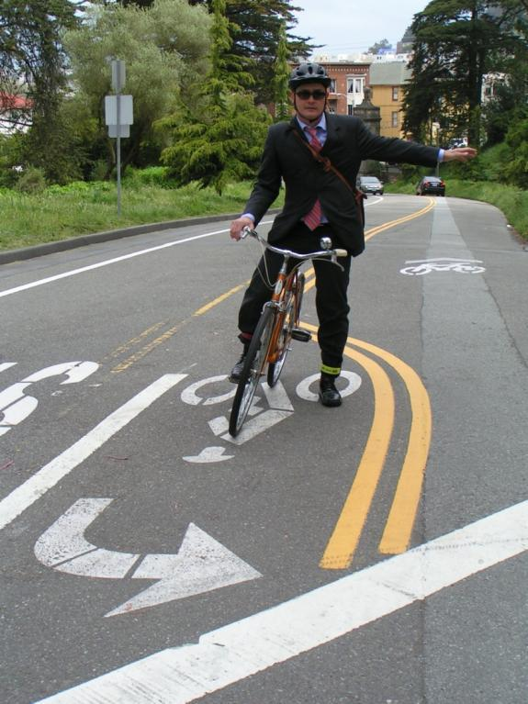
Benefits for the business
Improved health
Lower health care costs
Decreased absenteeism
Increased productivity
Reduced parking costs
Improved morale and happiness
Notes:
Improved employee health has a tremendous benefit for a business:
Decreased absenteeism
Increased productivity
Reduced health care costs
As a quick example: Quality Bicycle Products tracked their commuter program riders for the last three years and compared the expenditures to the average cost throughout their home state of Minnesota. The company saved $170,000 in health care costs in just those three years alone.
Reduced parking costs
It costs the same to build parking for 75 bikes as it does for just 4 cars.

Slide 7
Benefits for the employee
More energy throughout the day
Improved health and happiness
Lower travel costs
Increased travel options
Reduced parking costs
Notes:
Benefits for the employee include:
-More energy throughout the day
-Improved health and happiness
-Lower travel costs
-Increased travel options
-Reduced parking costs
A 200-pound cyclist burns 546 calories by bicycling 12 miles in one hour - almost the equivalent of a Big Mac®. Exercise and Your Heart -- A Guide to Physical Activity. National Heart, Lung, and Blood Institute / American Heart Association, DHHS, PHS, NIH Publication No. 93-1677 and McDonald's. (http://www.mcdonalds.com/)
The average American househould spends over $8,000 per year on owning and driving their cars. (It costs about $300 a year to maintain a bike.) U.S. Bureau of Transportation Statistics; Moritz, 1997

Slide 8
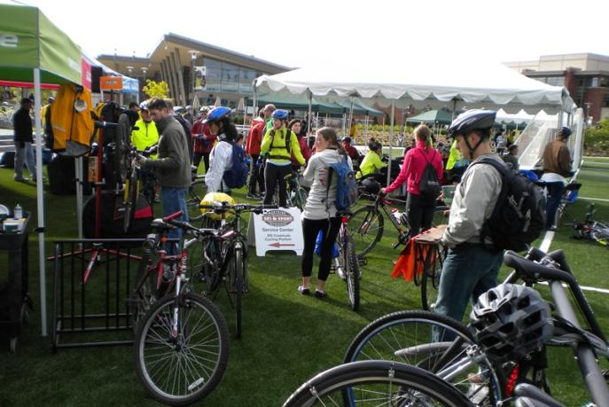
Benefits for the community
Better quality of life
Less traffic congestion
Improved air quality
Improved economy
Notes:
Benefits for the community include:
-Better quality of life
-Less traffic congestion
-Improved air quality
-Improved economy

Slide 9
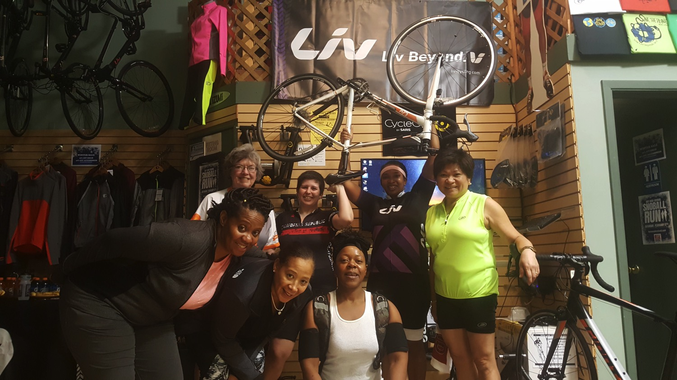
Application criteria
Online application www.bikeleague.org/business
Questions divided into the Five E’s:
Encouragement
Engineering
Education
Evaluation & Planning
Equity & Inclusion
Notes:
The on-line application asks a series of questions in each of the five major areas: Engineering, Education, Encouragement, Evaluation & Planning, and Equity & Inclusion. The program designates businesses at four levels: Bronze, Silver, Gold, and Platinum.
The next few slides are dedicated to discussion of each of the five E’s.

Slide 10
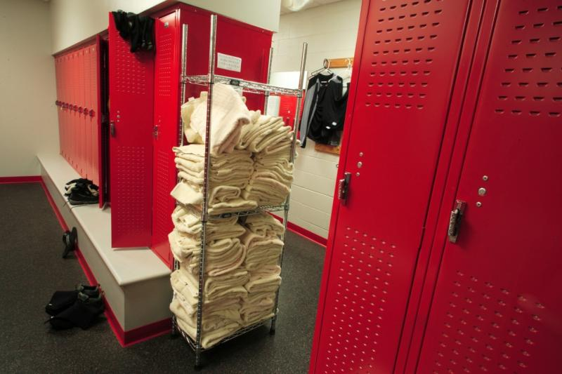
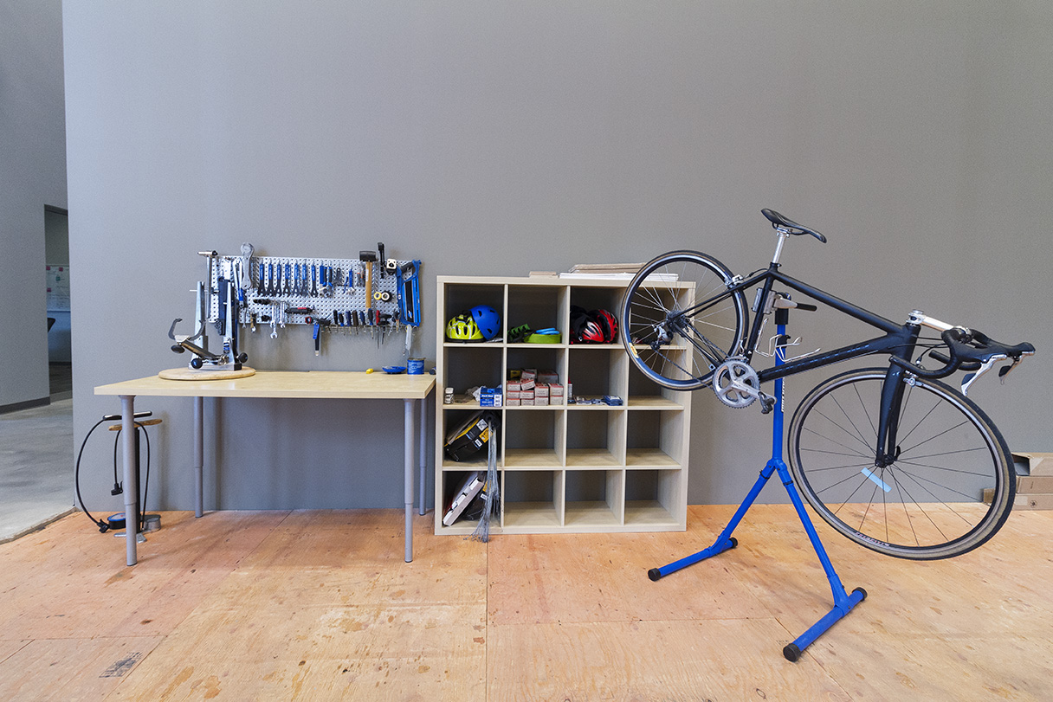
Engineering
Showers and lockers
Secure bike parking
Pump, repair kits
Accessible by bike
Notes:
Engineering
Engineering assesses a business’s commitment to bicycling through infrastructure improvements. Secure and convenient parking are essentials to welcoming bicyclists to the workplace. Engineering also includes showers, lockers, and/or a place to store cycling gear, bike share systems or office loaner bikes, simple maintenance supplies, and dedicated maintenance space.

Slide 11
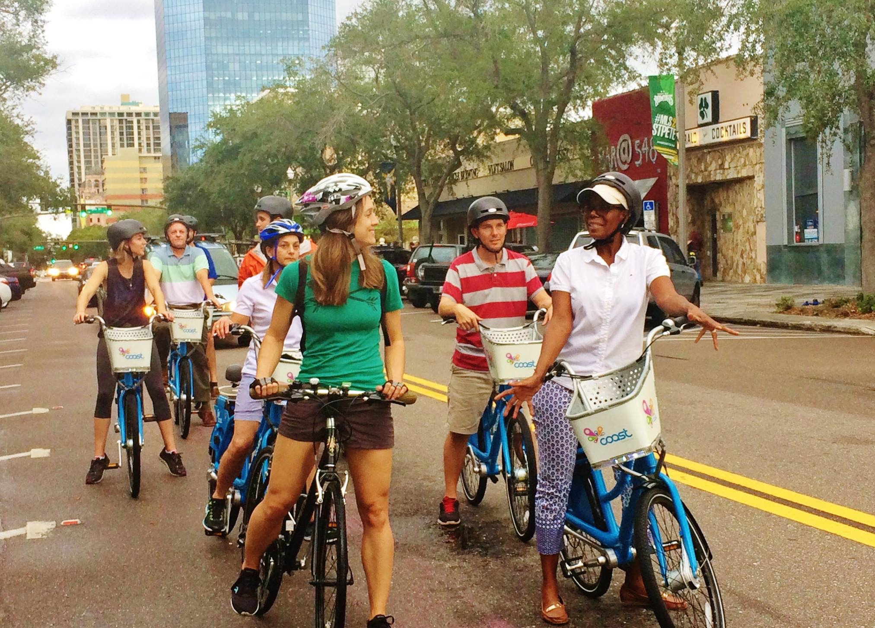
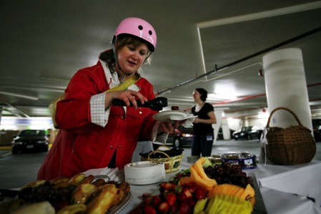
encouragement
Celebration of Bike to Work Day
Incentives to ride
Social rides at lunch or after work
Support of local cycling events
Sponsor a local advocacy group, team, or club
Shared bikes
Participation in a Commuter Challenge
Notes:
The second section of the application deals with Encouragement –
-celebrating Bike to Work Day,
-hosting group rides, including casual, social rides at lunch or after work
-offering other incentives to ride such as cash, healthcare discounts, coffee coupons, raffles and breakfasts.
-Is there a bike club or employee cycling commuter group at the business?
-Is there a commuter challenge?
-Does the business sponsor employees to participate in charity rides or bicycle racing?
-Does the business support local bike advocacy efforts or groups?
-Are there shared bikes at the business for employees to borrow for quick trips, errands, deliveries, or their lunch break?

Slide 12
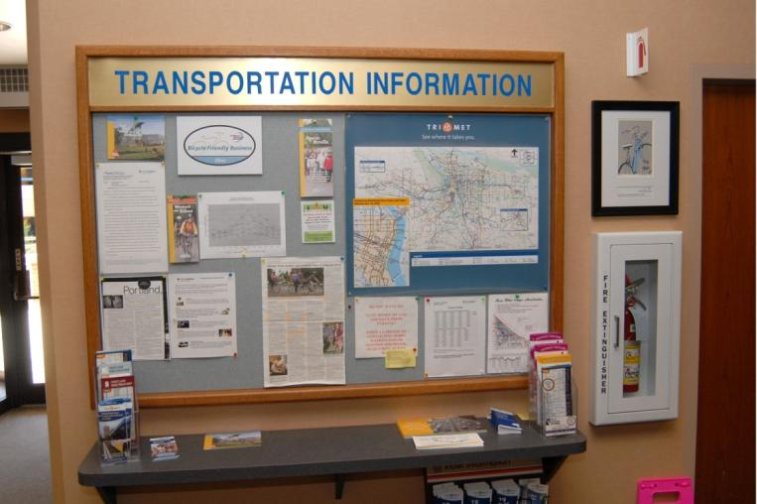
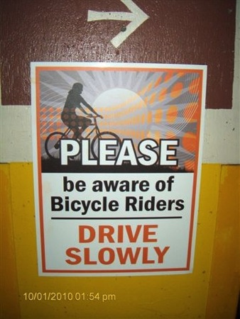


education
Commuter classes
Maintenance classes
How to share the road in your vehicle safety guidelines
Distribution of bike safety information
Notes:
Education is a key component of any bicycle friendly business. It is an essential building block for bicyclists of all experience levels and is also a very cost-effective way to promote safe cycling.
Examples of education include:
recurring bicycle education classes or maintenance classes taught by a League Cycling Instructor or a local bike shop employee or advocate.
Bicycle safety information is included in the employee handbook, orientation, or annual class.
Information on how to share the road with cyclists in the driver safety manual
Find more resources at https://bikeleague.org/ridesmart

Slide 13
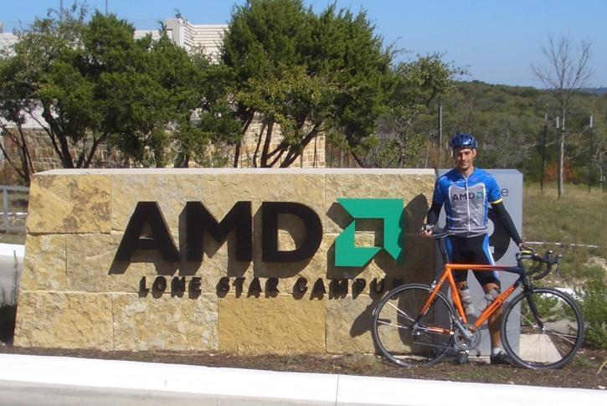
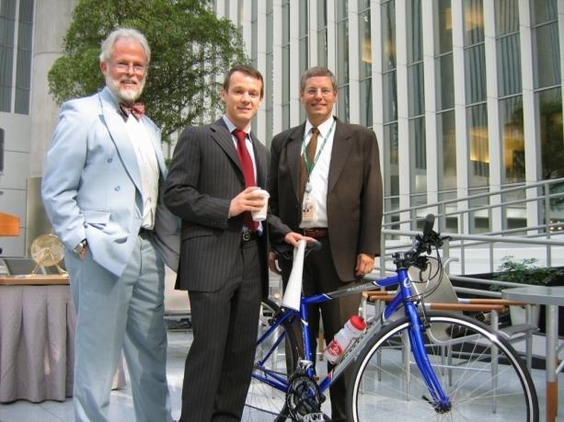
Evaluation & planning
Distribution of transportation survey
Annual goals of ridership
Recurring bike counts
Collection of commuter data
Notes:
The evaluation segment is an assessment of what’s already being done and what to aim for in the future;
Is there in-house bike coordinator?
Do you have target ridership numbers?
Is commuter data collected? (# of bike commuters, days ridden, miles ridden, etc.)

Slide 14
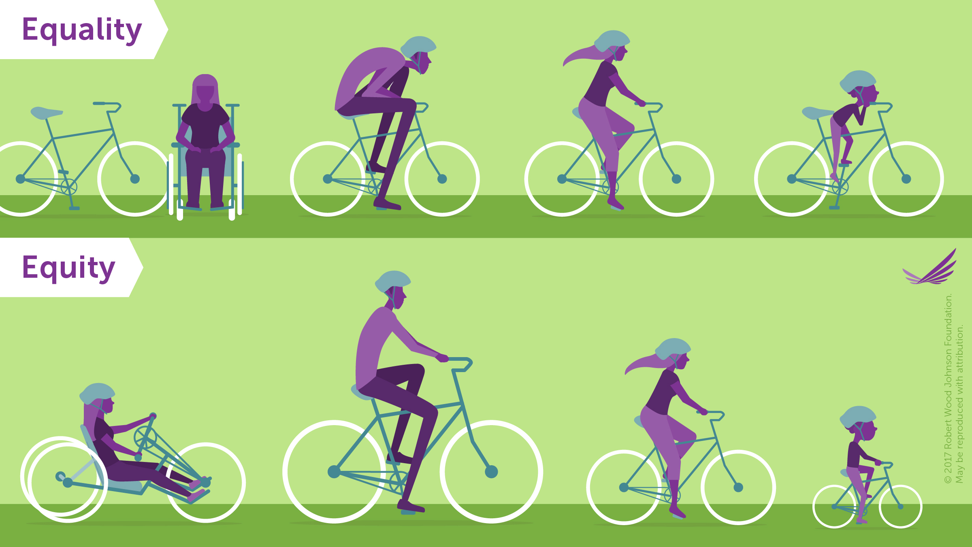
EQUITY & INCLUSION
Engineering
Encouragement
Education
Evaluation & Planning
Equity & Inclusion
Notes:
In each of the previous “E” sections, businesses will be asked to describe how they have ensured that the facilities, programs, services, classes, events, and evaluation/planning efforts are all done as equitably and inclusive as possible.
A major principle of equity is recognizing that not every bicyclist or potential bicyclist faces the same barriers or challenges, and therefore the same solutions will not work for everyone to make biking to work/the business safer, more comfortable and more accessible.
Every BFB is encouraged to work with and listen to their employees, customers, and guests to identify and eliminate barriers to commuting by bike.

Slide 15
Application review Process
Online application completed by business
  http://apply.bikeleague.org
3 Submission deadlines per year
  See upcoming deadlines: https://bikeleague.org/BFB_Fee_Deadline
Applications are reviewed by team of League Staff
Feedback received via surveys from employees, customers, local cyclists and advocates (Survey is optional but strongly encouraged)
Awards announced 2-3 months after deadline
Feedback to every applicant, regardless of award level
Notes:
To be considered for a BFB award, a business must submit an online application to the League at apply.bikeleague.org
There are 3 submission deadlines per year, in February/March, June/July, and October/November. (Find the current list of upcoming deadlines here: https://bikeleague.org/BFB_Fee_Deadline )
After a business submits the application it is evaluated in two ways:
1. A team of League staff review the applications internally
2. Employees, customers, local bike advocates, LCIs, etc., are asked to provide their perspective on the bicycle-friendliness of the business.
This last stage of the review is important to us, and local reviewers have definitely had an impact on many of the awards. All feedback received by local reviewers are included (anonymously) into the final feedback report given to the business.
Awards are typically announced 2-3 months after the submission deadline
Feedback is provided to every applicant, regardless of award level, and awardees receive an announcement toolkit to help them celebrate and promote their new BFB designation.

Slide 16
Application Cost
Size of Location | Application Fee
1-49 employees OR non-profit/government | $50
50-499 employees | $100
500-999 employees | $250
1,000+ employees | $500
Notes:
The BFB application fee is based on number of employees at applying location:
1-49 employees or non-profit/government (of any size): $50
50-499 employees: $100
500-999 employees: $250
1,000+ employees: $500
Corporate members of the League may apply for free (limit one free application per year)
All BFB awardees must renew once every four years to maintain their designation.
Discounts are available for renewing BFBs, as well as for women-owned businesses and minority-owned businesses. Contact bfa@bikeague.org to learn more.

Slide 17
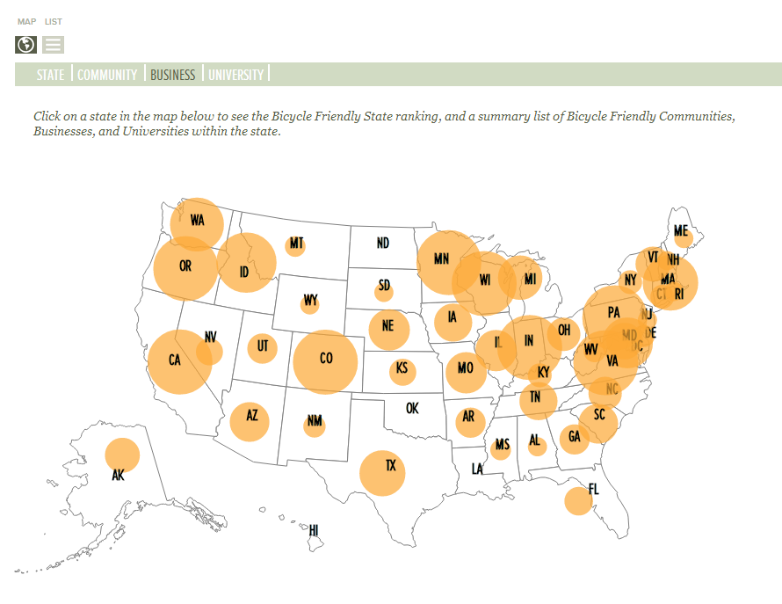

National Recognition
http://bikeleague.org/bfa/awards
Notes:
There are currently 1,400+ businesses that have received a bronze or higher Bicycle Friendly Business designation across the U.S. There is an interactive awards database map available at http://bikeleague.org/bfa/awards

Slide 18
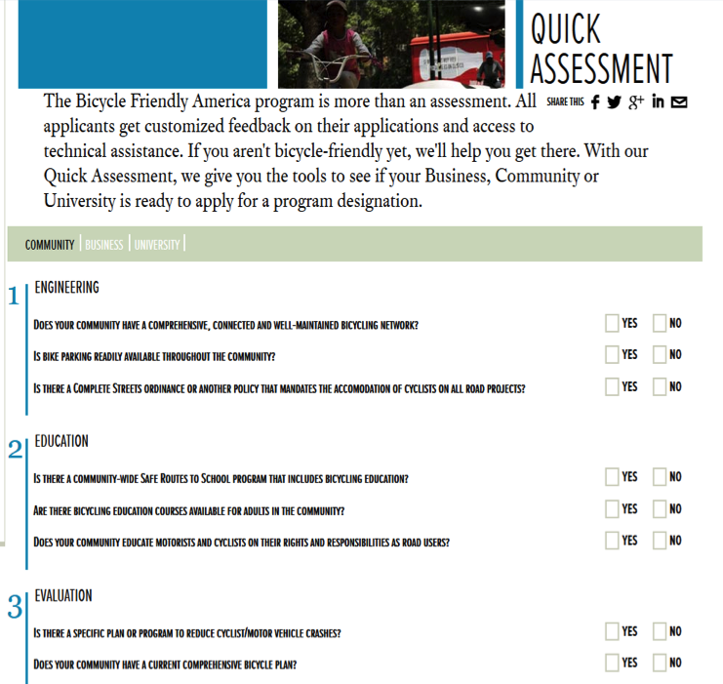
BENEFITS OF THE PROGRAM
Recognition
Promotion
Inspiration
Feedback
Apply online at bikeleague.org/business
Notes:
In addition to the many benefits we looked at earlier such as improved employee health, lower rates of absenteeism, improved morale, decreased parking costs, and lower health care costs, the agency receives many benefits in just going through the BFB application process.
Recognition and Promotion: Each awarded business is designated for four years, after which time they must reapply to maintain or improve their award. Awarded businesses are listed on the League website and included in a national press release. Awardees are also given a local press release template to help promote the news of their award.
Inspiration: One objective of the BFB program is to let you know that you are not alone in advocating for better bicycling conditions in your workplace. Tens of thousands of bicyclists across the US aspire for better accommodations in the workplace.
Feedback: This is one of the key components and one that is valued by all applicants. The League provides an extensive list of suggestions to create a more bicycle friendly workplace to help you improve. Every applicant, whether they receive a BFB designation or not, will receive feedback from the League.

Slide 19
QUESTIONS?
[Insert your contact info here]
www.bikeleague.org/business
bfa@bikeleague.org
Notes:
Thank you.
[Take questions and encourage businesses to apply. For answers on more detailed questions ask them to consult the website or contact the League.]

Slide 20
THANK YOU!
www.bikeleague.org/business
bfa@bikeleague.org

