Slide 1

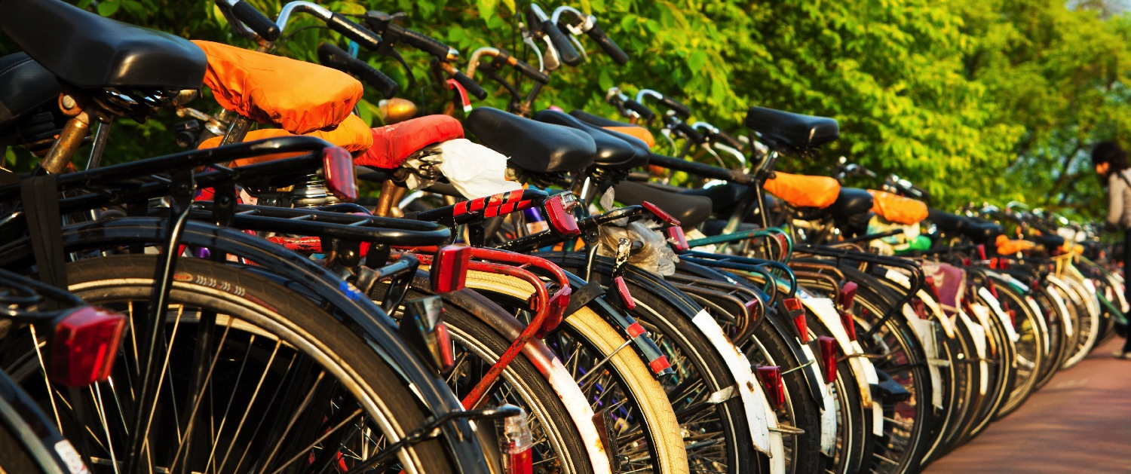
Bicycle friendly America program overview
[Insert name, affiliation and date]
Notes:
[Thank your audience for coming and introduce yourself.]
The Bicycle Friendly America program is a program of the League of American Bicyclists and I am here to assist to get the most out of the program.

Slide 2

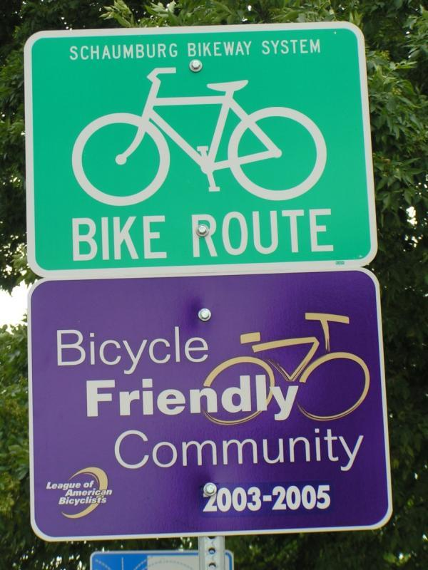
A Little BFA Program History
1995: Began with the BFC program
2002: application expanded & framed by Five E’s; Bronze-Platinum Award levels created
2008: BFB and BFS programs added
2011: BFU program launched
2012: Diamond award level created
2020: Evolution of the Five E Framework
Notes:
The birthplace of the Bicycle Friendly America Program was in the Bicycle Friendly Community Program, which was created by the League of American Bicyclists in the 1990’s - at first with relatively easy criteria for communities to meet. In 2002 the program was overhauled and a new, more rigorous application and review process was initiated. With the assistance of the Robert Wood Johnson Foundation and the Pedestrian and Bicycle Information Center, the League improved the outreach of the program and the amount of technical assistance to applying communities.
One important change was the creation of a five tiered award system – created with the intent of encouraging communities to continually improve.
In 2008 the League expanded the program to include businesses and states. In 2011 the program grew again to recognize and assist colleges and universities in the Bicycle Friendly University program.

Slide 3




Providing a roadmap for a bicycle friendly America
Advocacy – Coordination, feedback, setting the bar
Education –Measurement, feedback, hands-on assistance
Promotion – Award designation, media, publications
Notes:
The benefits of bicycling are clear – it is not a special interest but a tool to creating more economically robust, active and vibrant communities, businesses and universities.
The BFA program sets a standard and provides the tools to reach it. The program itself is valuable for coordination, benchmarking, providing ideas/education for improvement through the application and feedback and lastly it is recognition for all of the great work.

Slide 4
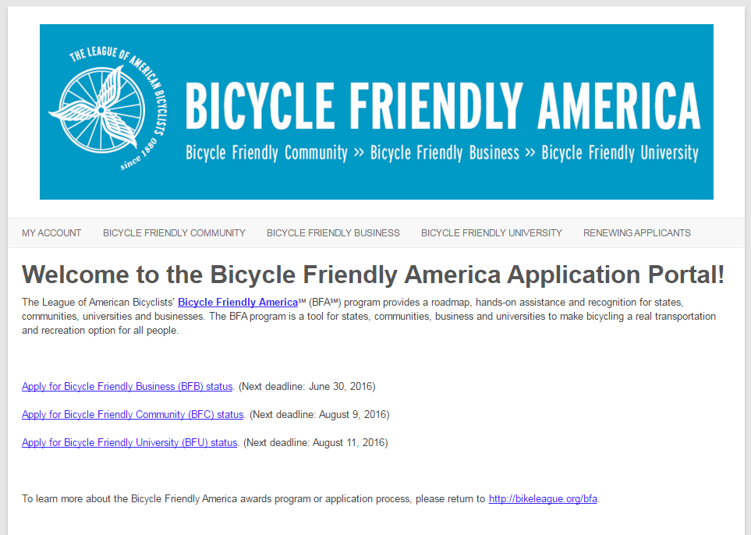
Application Criteria
Online application questions divided into Five E’s:
Engineering
Education
Encouragement
Evaluation & Planning
Equity
http://apply.bikeleague.org
Notes:
The online application form asks a series of about a dozen questions in each of five major areas of bicycle policy and programs. To reach the higher levels of award, communities, businesses, and universities must score well across all five areas. Bikeleague.org provides best practices that correspond to these questions in a Resource Library bikeleague.org/BFA

Slide 5

Application Review
Reviewed by staff and external reviewer
Feedback from local cyclists and advocates
A roadmap and assistance to improve
Notes:
After a applicant submits the application and sends any appropriate supporting literature, the application is reviewed three ways:
League staff review the applications internally
An external reviewer is asked to score each application, and
Local cyclists – League members, LCIs, club leaders etc., are asked to comment on the application and provide their perspective on the bicycle-friendliness of the place.
This last stage of the review is important to us, and local reviewers have definitely had an impact on many of the awards – or lack of awards.

Slide 6
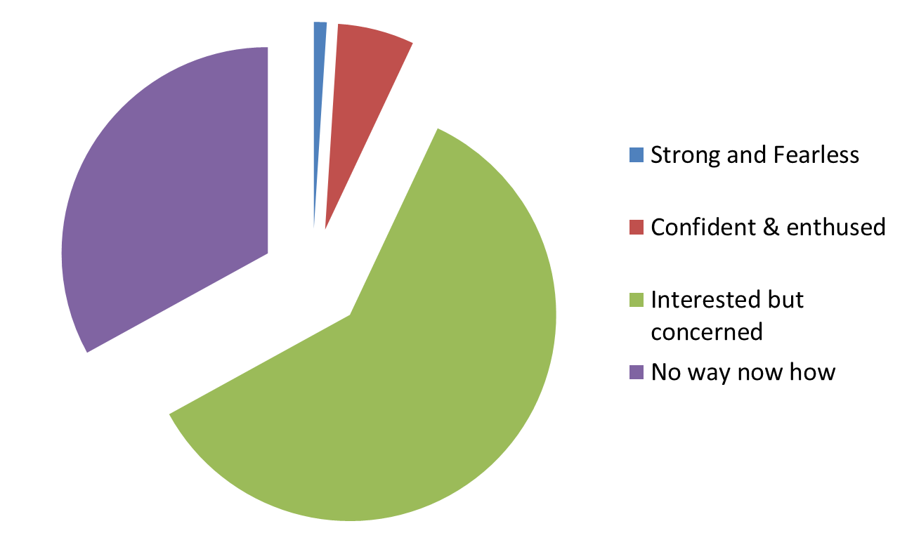
Reaching the Interested but Concerned
Notes:
Each of these programs is aimed at helping communities, businesses, and universities welcome people of all ages and abilities to get on a bike and go comfortably and conveniently for recreation and transportation.
Thanks to some very interesting research conducted in Portland, Oregon we can group folks by their level of comfort, with the goal of accommodating as many people as possible. As it turns out over half of the population would like to bike more but are not really being given viable choices for doing so. We want to change that. Now just a bit about these groups.

Slide 7
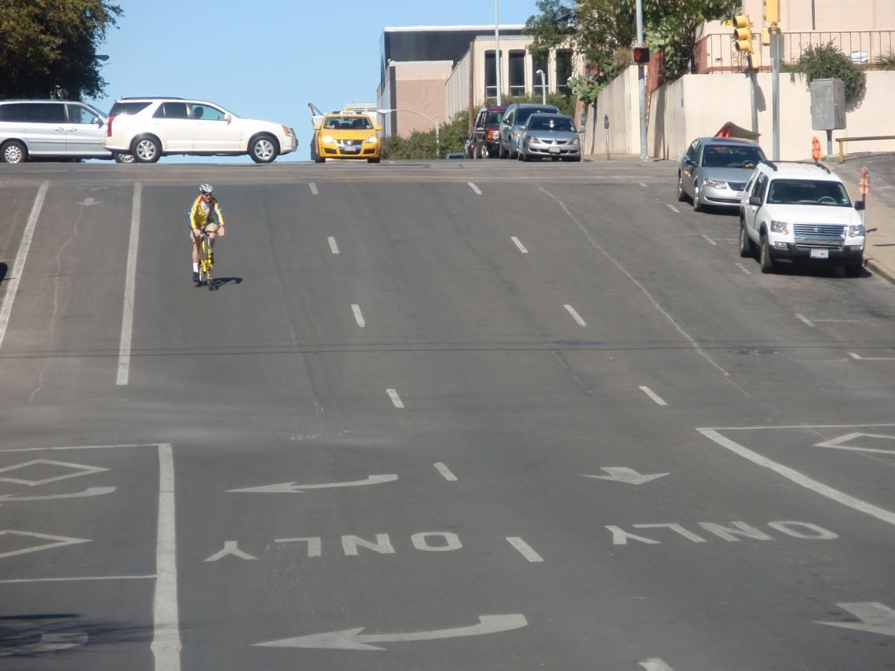
Strong and Fearless
Notes:
First, the Strong and Fearless. This group represents about 1-3% of the total population. They really don’t need a lot to get to where they want to go on city streets. They need the protection in the law to use the streets, but dedicated bike facilities are not necessary for them. Smooth roads, signals that are actuated by them and a safe bike parking are some of the most important factors for them.

Slide 8
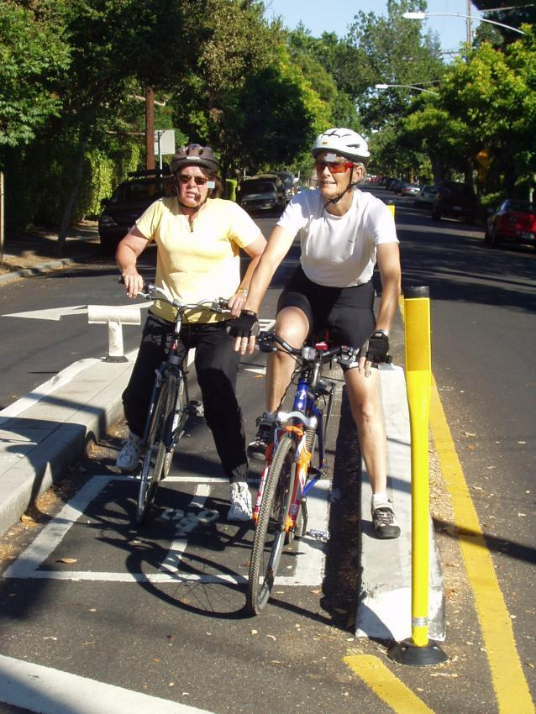
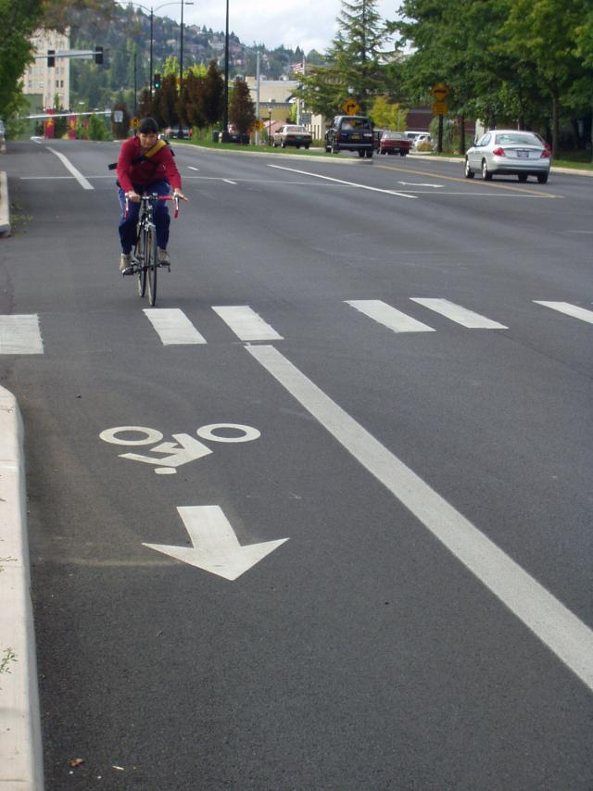
Enthused and Confident
Notes:
Next, the Enthused and confident. The “Enthused and Confident” are those who have been attracted to bicycling by improvements to the bikeway network and supporting infrastructure. They are comfortable sharing the roadway with automotive traffic, but they prefer to do so operating on their own facilities like bicycle lanes, bicycle boulevards and cycletracks.

Slide 9
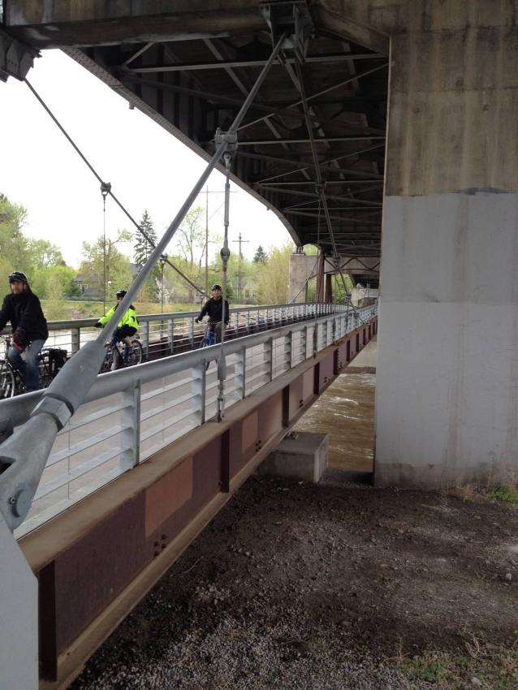
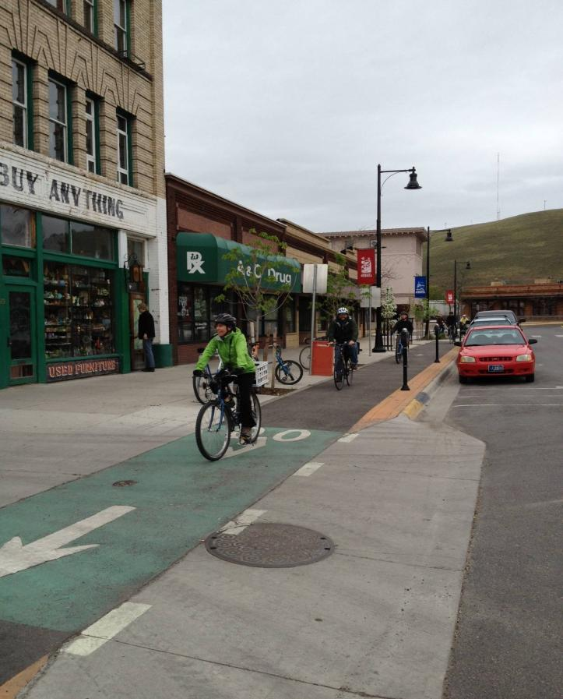
Interested but Concerned
Notes:
The largest portion, the Interested but Concerned, are curious about bicycling. They like the idea of riding more but they are afraid to ride. They don’t like the cars speeding down their streets. They get nervous thinking about what would happen to them on a bicycle when a driver runs a red light, or guns their cars around them, or passes too closely and too fast.
Very few of these people regularly ride bicycles—some will ride recreationally, join a group ride event or ride to a close destination as long as it doesn’t include going on major streets. They want separation from automobiles. They would ride if they felt safer on the roadways—if cars were slower and less frequent, and if there were more quiet streets with few cars and paths without any cars at all. This group is being reached in the best bicycle-friendly places through innovative bikeway implementation – from buffered bike lanes and cycletracks to neighborhood greenway networks that lead to destinations.

Slide 10
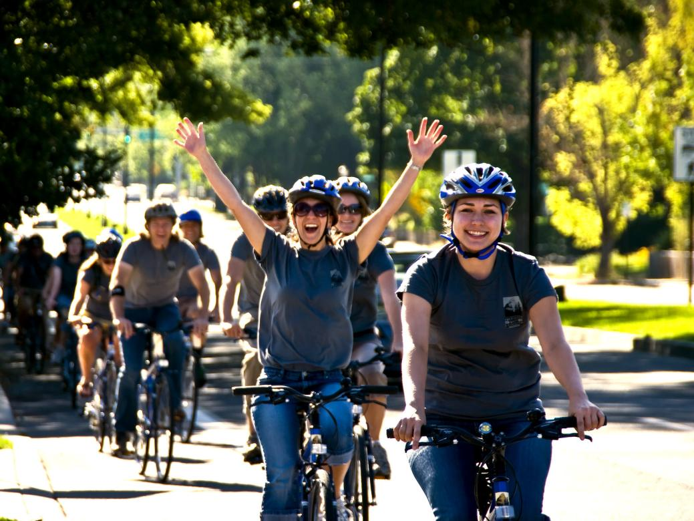
Interested but Concerned

Slide 11
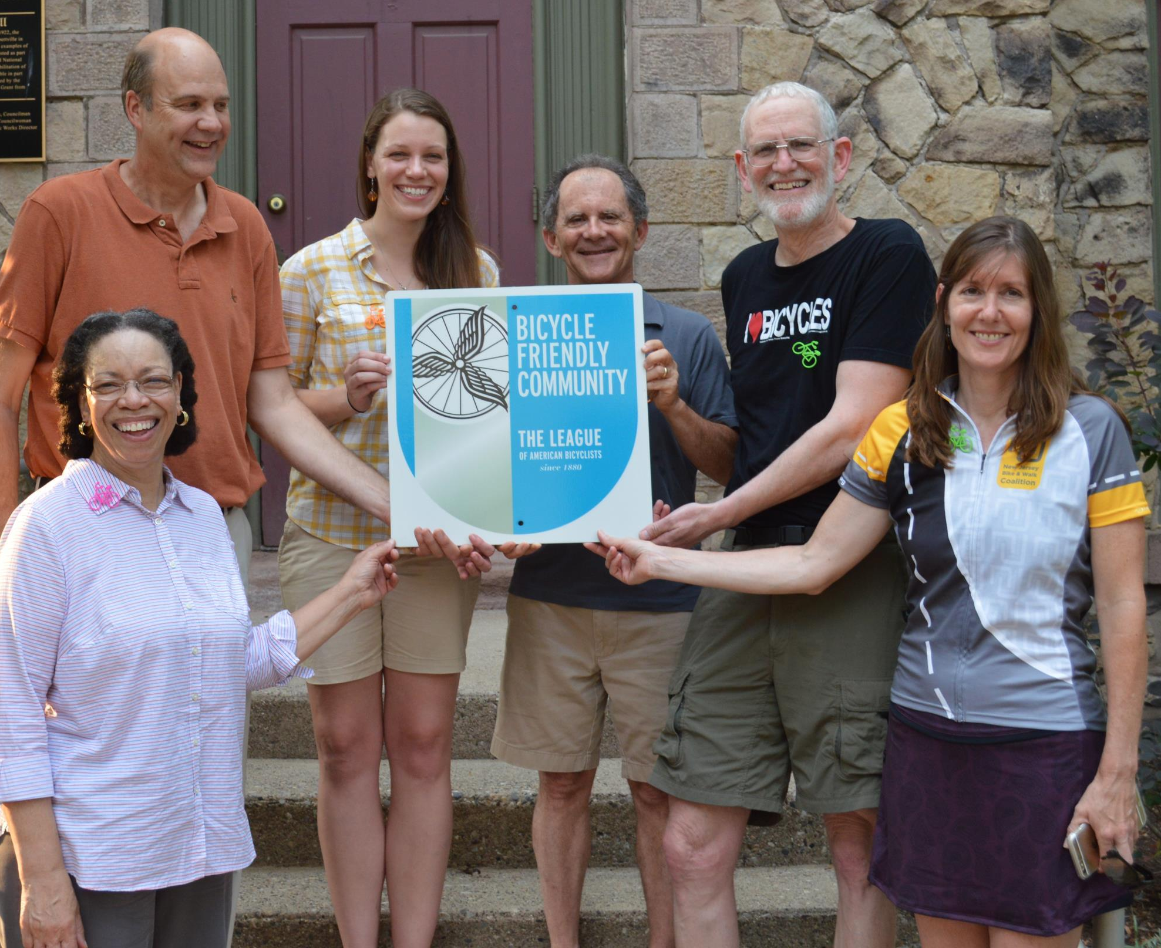
BFC Program
The Bicycle Friendly Community (BFC℠) program provides a roadmap to improve conditions for bicycling and the guidance to make your distinct vision for a better, bikeable community a reality.
Notes:
11
The Bicycle Friendly Community (BFC℠) program provides a roadmap to improve conditions for bicycling and the guidance to make your distinct vision for a better, bikeable community a reality.

Slide 12
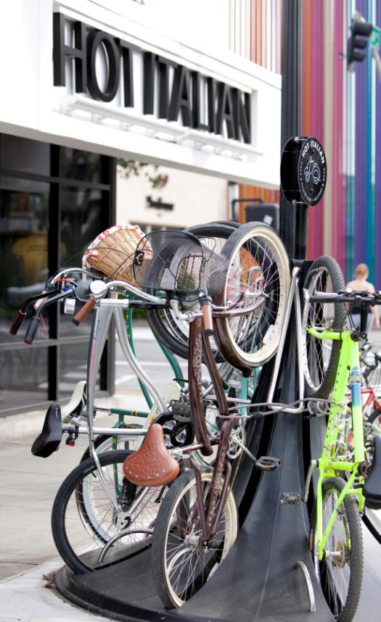
BFB Program
Through the Bicycle Friendly Business (BFB℠) program, employers are recognized for their efforts to encourage a more welcoming atmosphere for bicycling employees, customers, and the community.
Notes:
12
Through the Bicycle Friendly Business (BFB℠) program, employers are recognized for their efforts to encourage a more welcoming atmosphere for bicycling employees, customers, and the community.

Slide 13
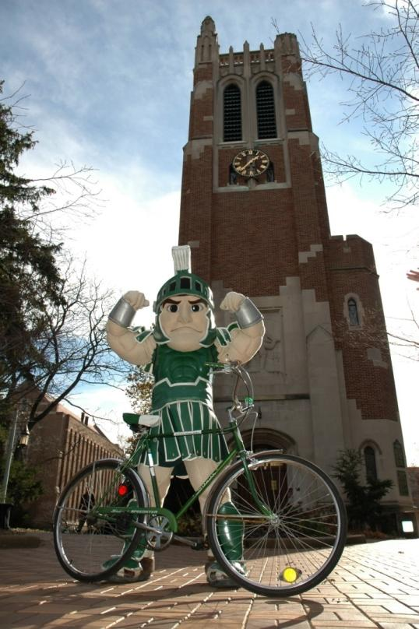
BFU Program
The Bicycle Friendly University (BFU℠) program recognizes institutions of higher education for promoting and providing a more bikeable campus for students, staff and visitors.

Slide 14
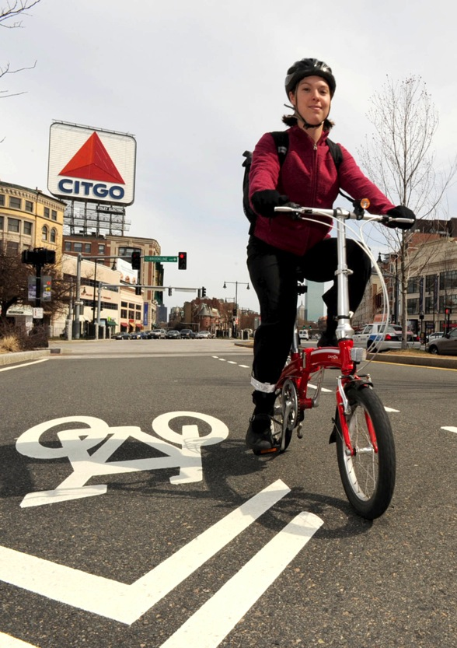
BFS Program
The Bicycle Friendly State (BFS℠) program is the annual ranking of all 50 states’ progress toward promoting and embracing biking for transportation and recreation.
Notes:
The Bicycle Friendly State (BFS℠) program is the biannual ranking of all 50 states’ progress toward promoting and embracing biking for transportation and recreation.

Slide 15
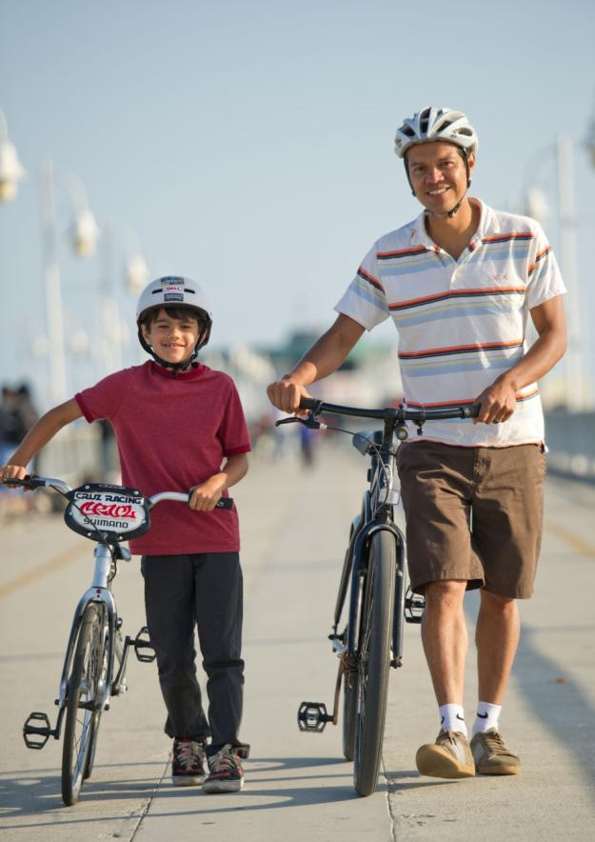
Benefits of applying
“We knew this recognition would be important to our civic and business leaders, and that the metrics set out in the League’s application would be important measures for us.”
- Allan Crawford, Bike Long Beach
Photo: Allan Crawford
Notes:
Over and over, we hear how useful the programs are for coordination, benchmarking and giving the deserved recognition to all of the people – from civic and business leaders to advocates and educators – for building a great bicycle-friendly America.

Slide 16
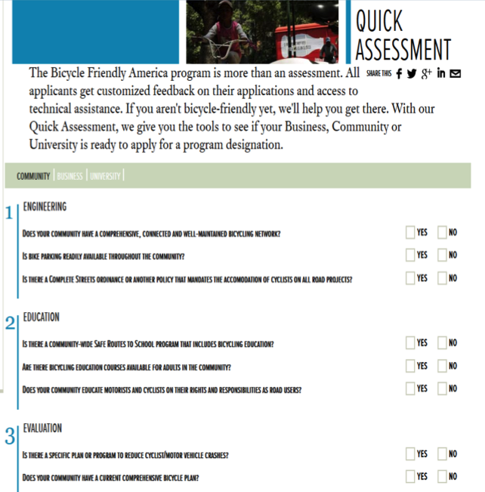
Get started
Go to: http://bikeleague.org/bfa
Review Getting Started Guide
Use Scorecard for self-assessment
Review the application and resources
Coordinate with your local bicycle group(s)
Apply online at: http://apply.bikeleague.org
Notes:
The first step in the process is usually visiting bikeleague.org/bfa and review the Getting Started guide, application and resources, and use the Scorecard to do a quick assessment of your community, business or university.
Your local bike group(s) should be brought into the discussion of applying and of course, working to build a stronger bicycle-friendly community, business or university.

Slide 17
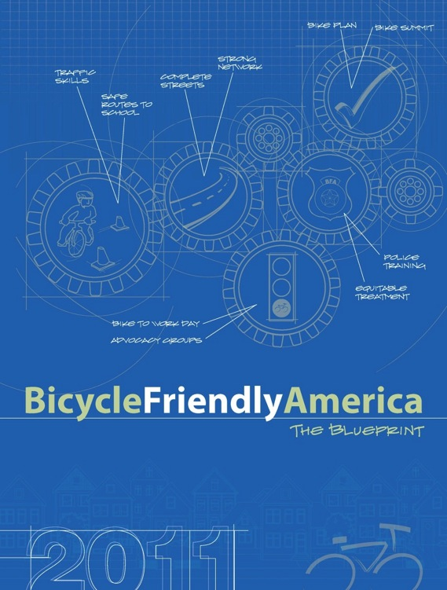

Online resource library
Notes:
The League’s online resources include best practices and success stories from colleges and universities of all shapes and sizes from every region of the country. The League’s Bicycle Friendly America program staff are available to answer your questions and help you through the process.

Slide 18
[Your contact info]
Notes:
Thank you.
[Take questions. For answers on more detailed questions ask them to consult the website or contact the League.]

Slide 19

Thank you!
Text

